Slide 1
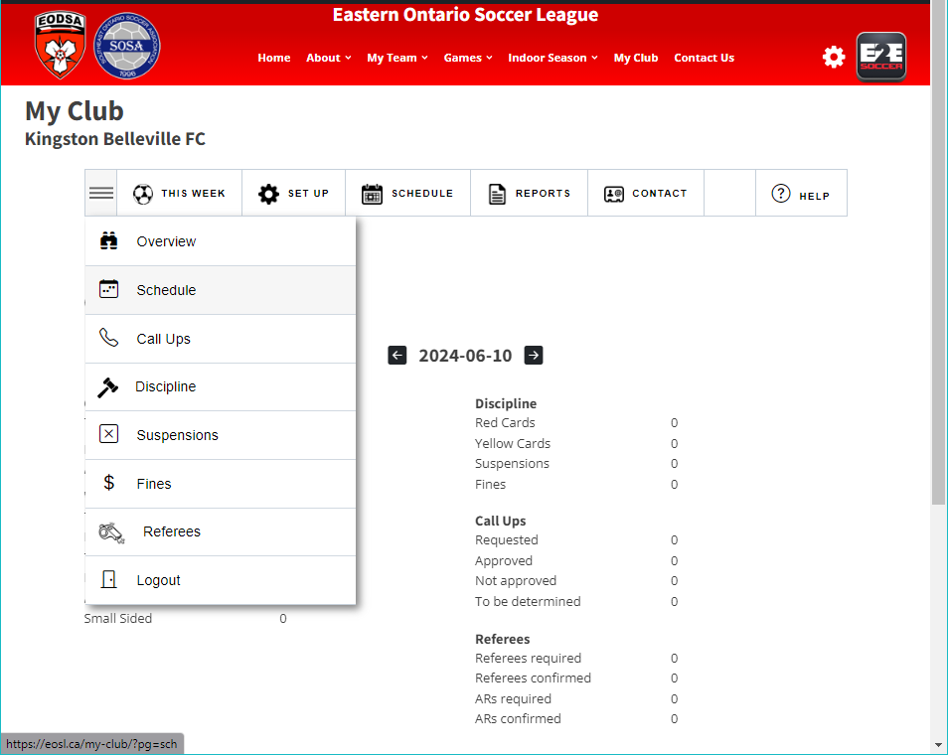
When logged in as the club, under THIS WEEK, there are tons of options to see how your teams are doing.
To view copies of game sheets, go to Schedule

Slide 2
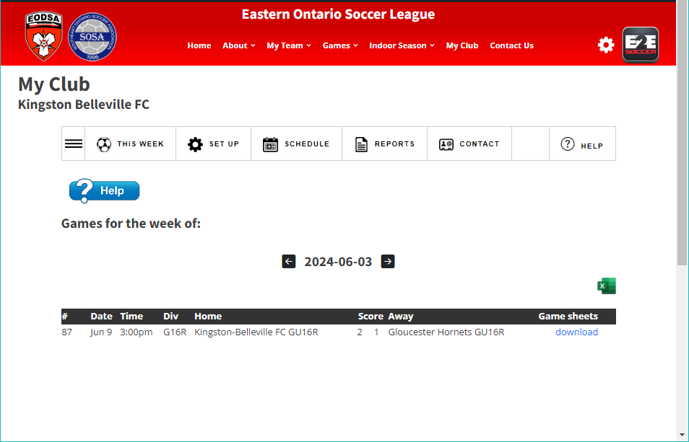
To view copies of game sheets, go to Schedule
You can scroll through the weeks for all games and download the game sheets submitted by the referee.

Slide 3
When logged in as the club, under THIS WEEK, there are tons of options to see how your teams are doing.
To view copies of Fines that have been issued, go to THIS WEEK than Fines

Slide 4
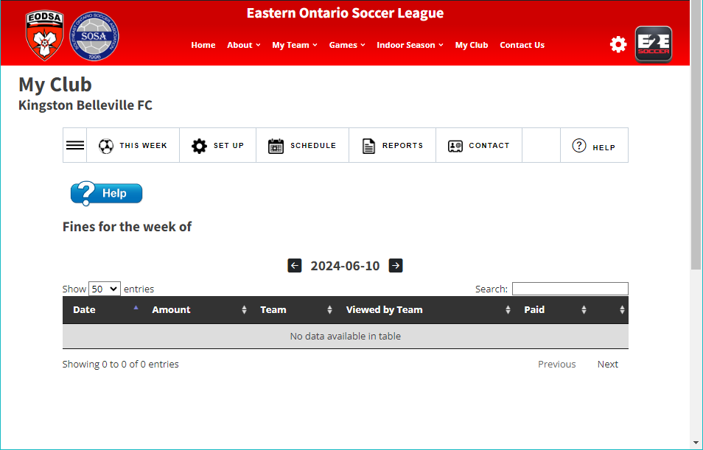
To see your teams fines, again under THE WEEK, and you can scroll through the weeks to see all fines.
This is the same for Discipline, Callups and all other options under THIS WEEK

