Slide 1
Eastern Ontario SL
Club Training

Slide 2
About E2E Soccer
Company was founded in 2003
We are located in Ottawa
We provide IT solutions for the soccer community
Our products allow our customers to automate their operations in a cost-effective manner
Our goal is to provide the customer with an end to end or E2E solution

Slide 3
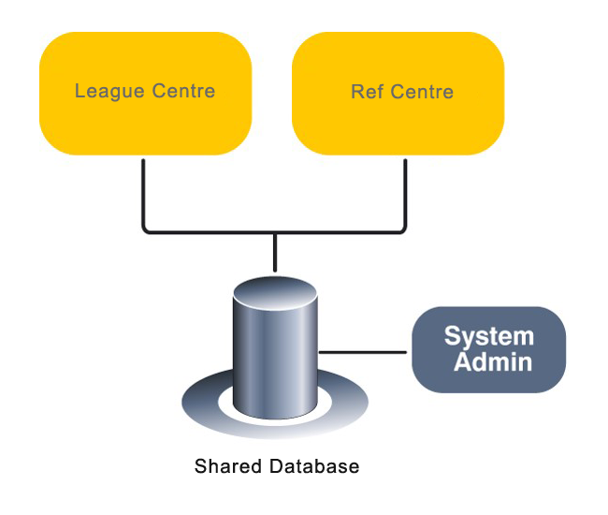
The Eastern Ontario SL solution

Slide 4
League management roles and responsibilities
League staff Club staff Team staff Players
Generate schedule
Review game sheets
Discipline management
Operate the league
Team oversight
Approve call ups
Club management
Generate game sheets
Submit game reports
Request call ups
Read only

Slide 5
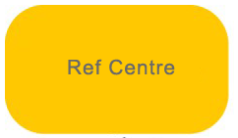
Referee management roles and responsibilities
League staff Club staff Assigner Referees
Referee oversight
Referee oversight
Assign referees
Support referees
Accept game offers
Submit game reports
Submit discipline
Upload game sheets

Slide 6
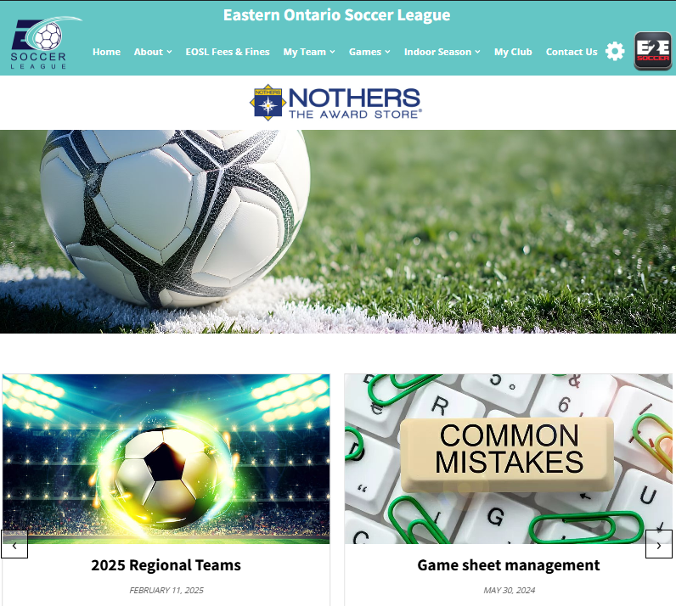
This is your website.
https://eosl.ca/
Go to the front office and click on My Club.
Then log in with the email and password in the email.

Slide 7
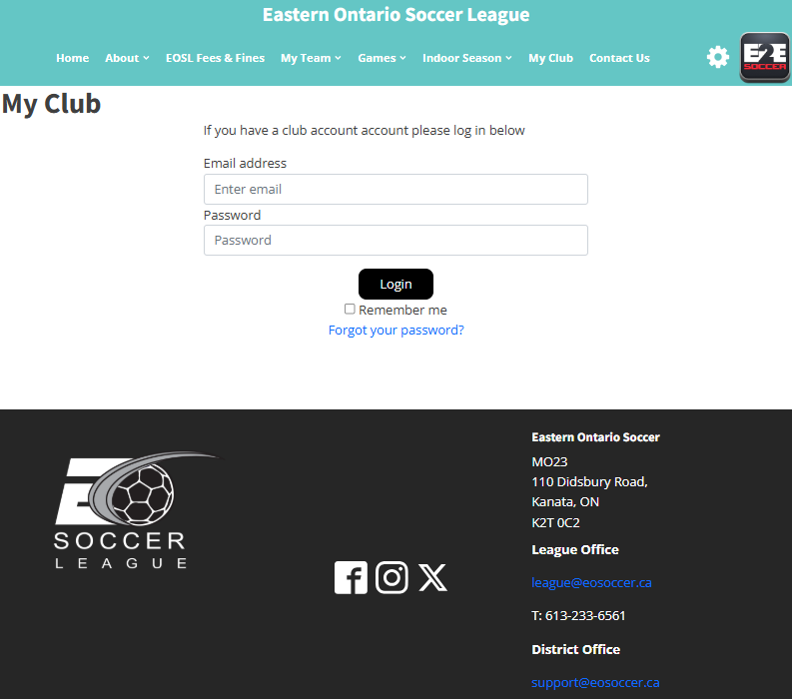
Log in using the email address and password that you have been given.
Use the “Forgot your password?” to reset your password

Slide 8
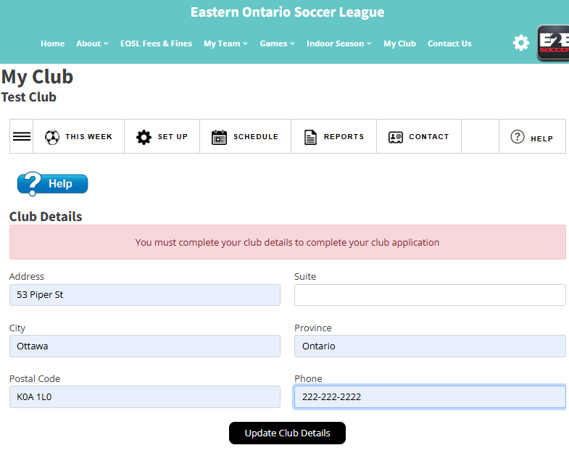
First time logging in, your club address must be updated.

Slide 9
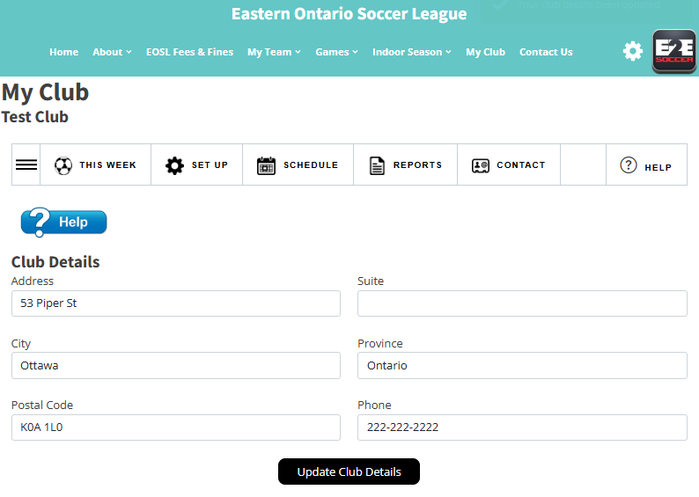
Your club name
The club module
has 5 menus

Slide 10
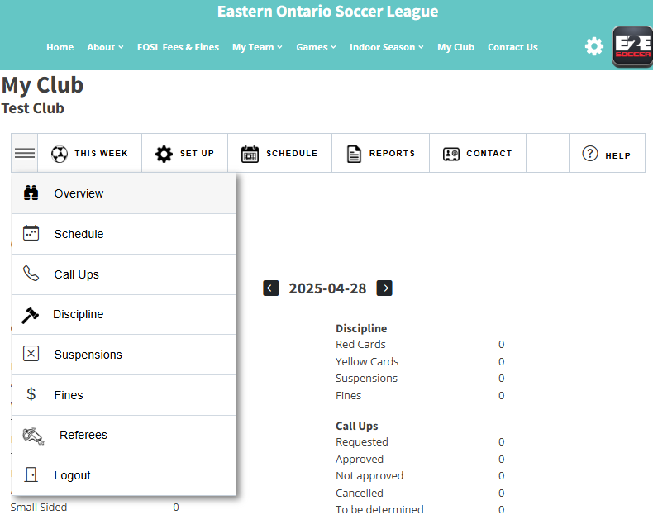
Use the 3 bars to see
the tools in each menu

Slide 11
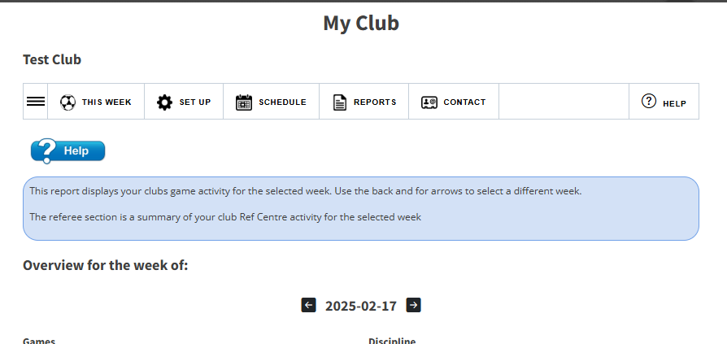
Click the Help icon for online assistance. A tool tip will appear.
Click the Help icon a second time and the tool tip will disappear.

Slide 12
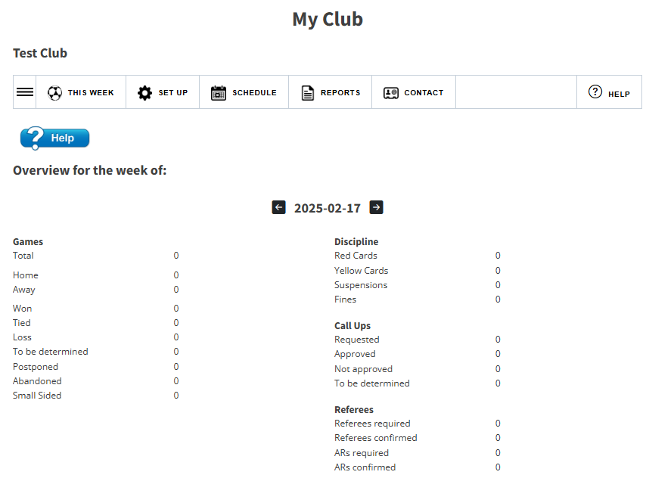
Your landing menu will be ‘This Week’
The tools in this menu report on you club for the selected week.
Your landing page is “Overview for the week”. It shows your statistics for this week's games.
Use the back and for arrows on the week to move to another week.

Slide 13
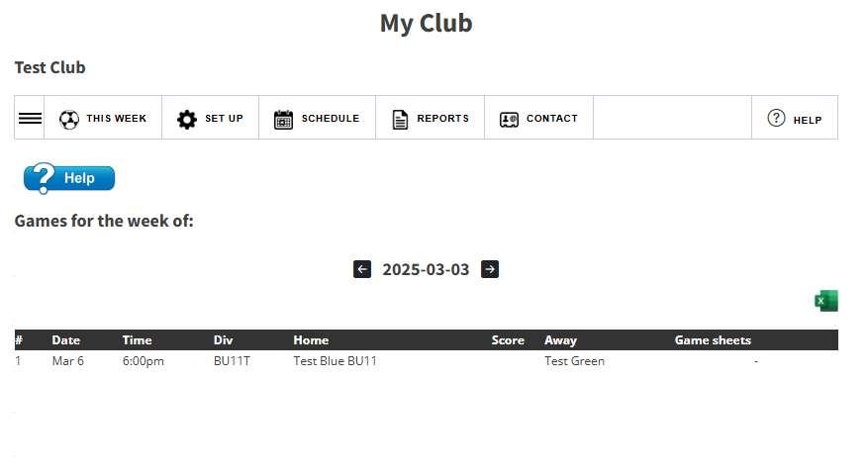
Games for the week for all teams within the club are listed.
Once the referee has uploaded their game sheets, a club can view them here.

Slide 14
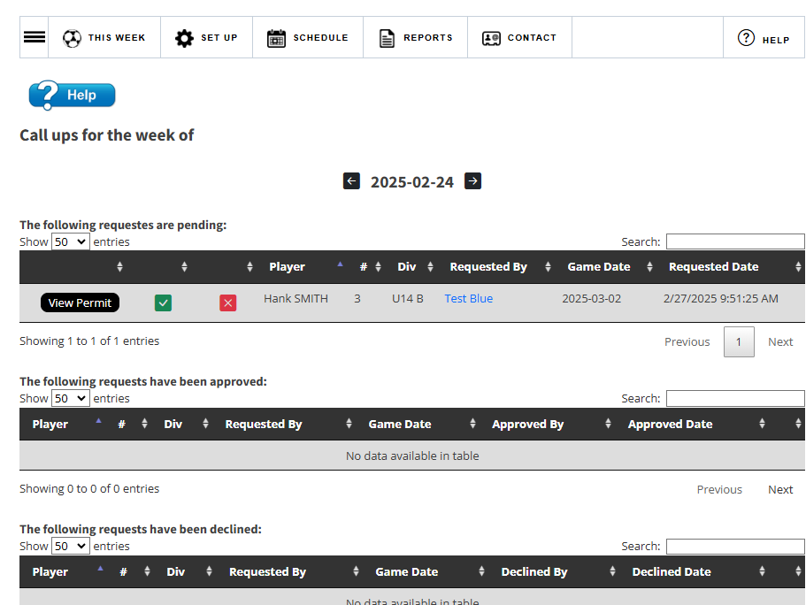
View your call ups for the week.
Click on the green check mark to approve and the red X to decline the call up.

Slide 15
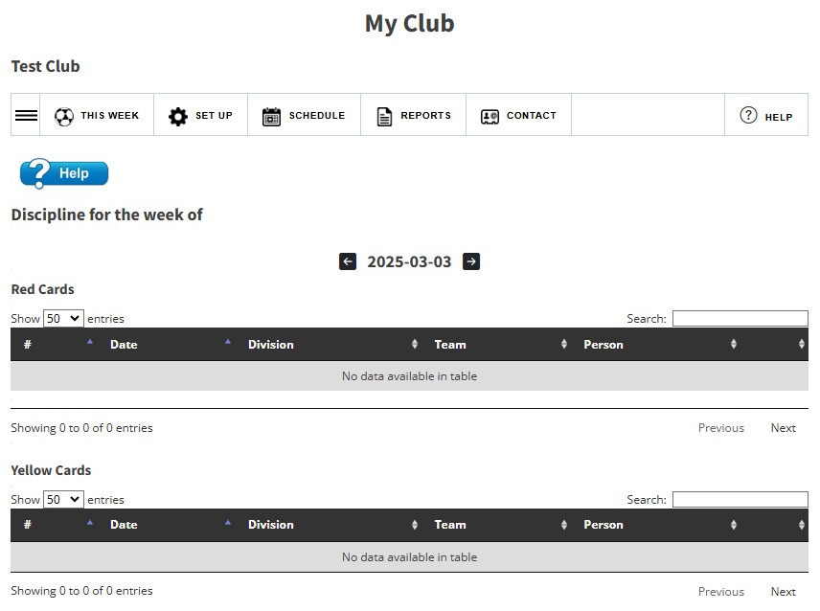
View your discipline for the week.

Slide 16
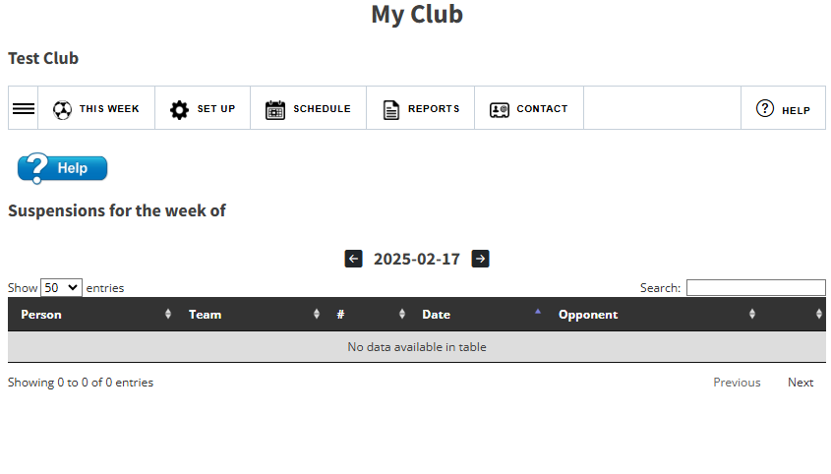
View who is suspended this week.

Slide 17
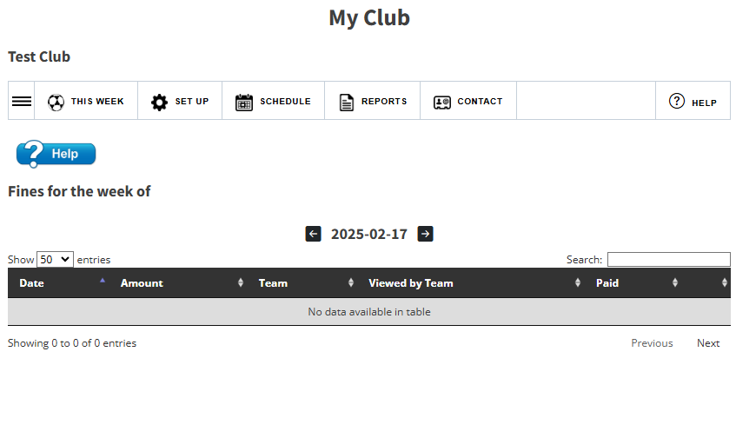
View your fines from this week.

Slide 18
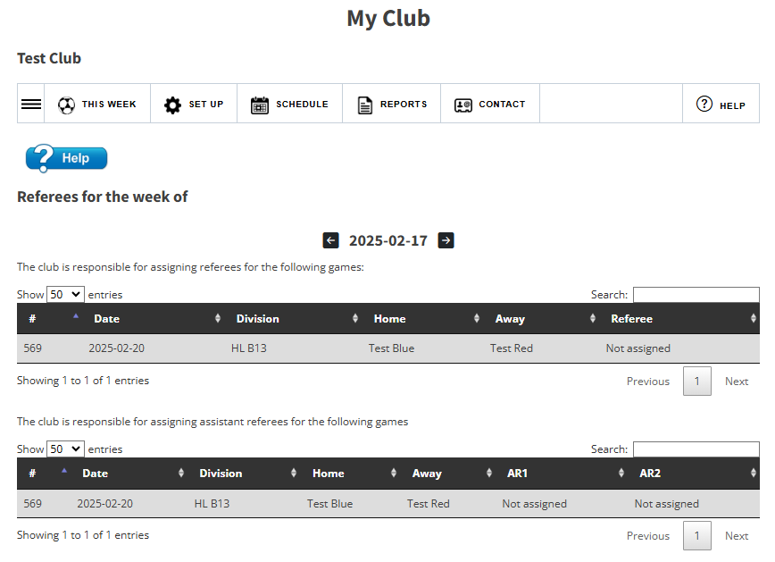
View your referees for the week.
This is read from Ref Centre.

Slide 19
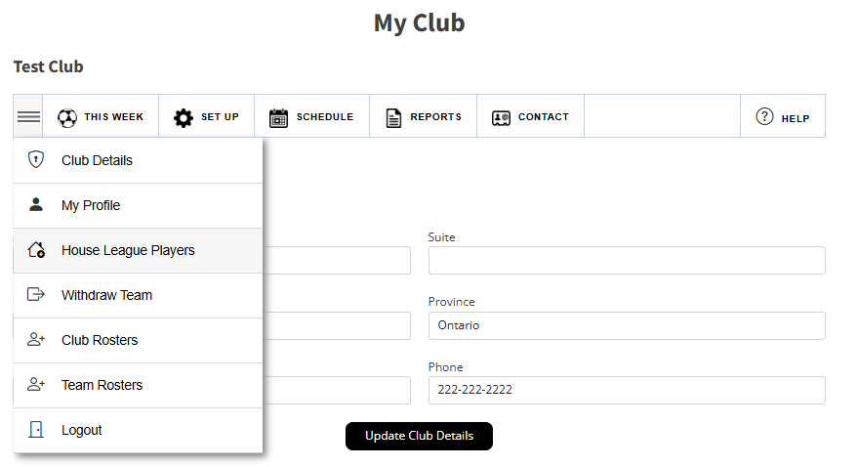
Set Up
The Set Up menu allows you to update your club detail.

Slide 20
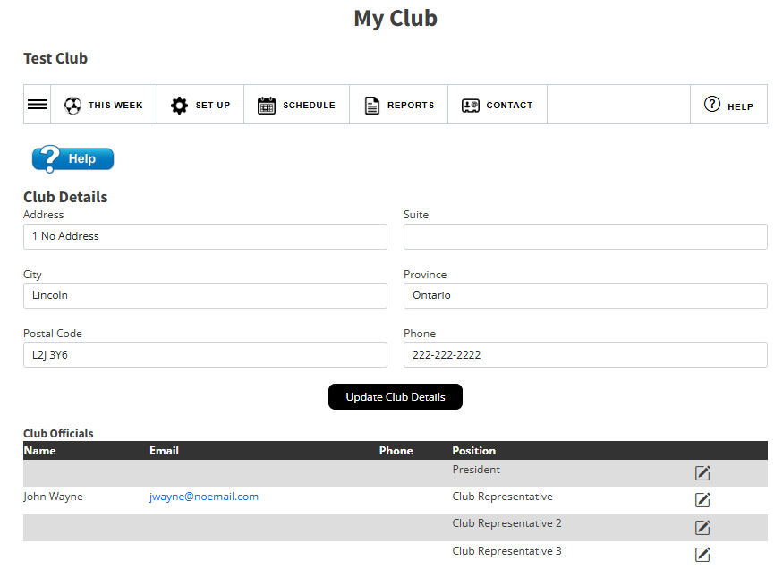
Manage your club profile and club officials on the Club Details page.
Use the pencil icon to update a club official

Slide 21
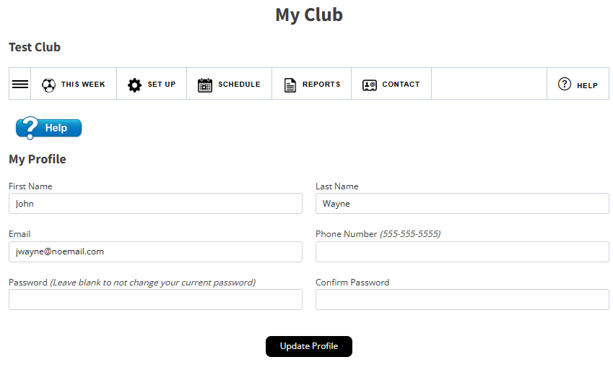
Manage your profile on the My Profile page.

Slide 22
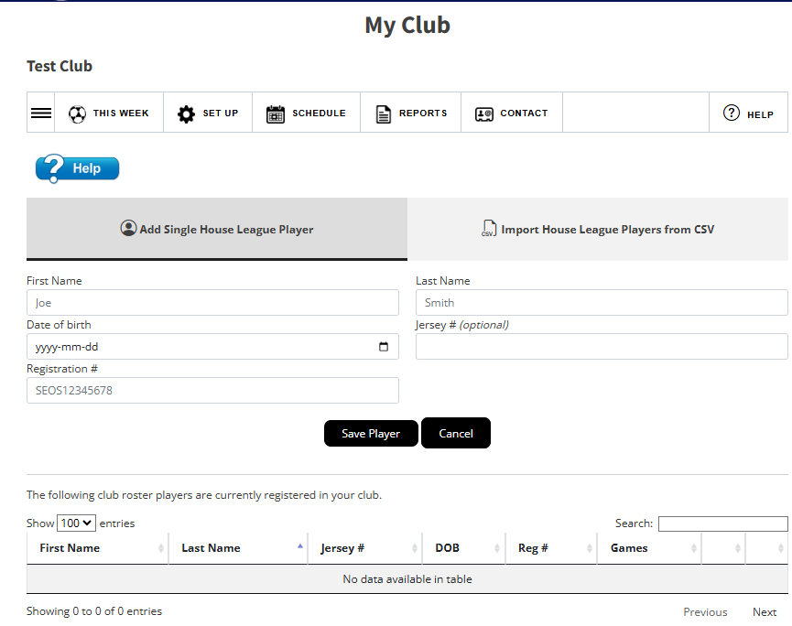
Adding house league players
Clubs can add house league players (those not within the EOSL) who can then be called up to a team within their club.
This can be done individually or through an CSV file.

Slide 23
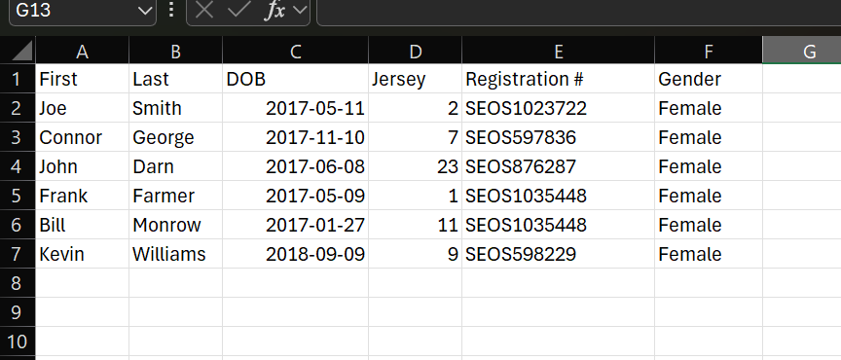
This is the ideal setting for your house league upload.

Slide 24
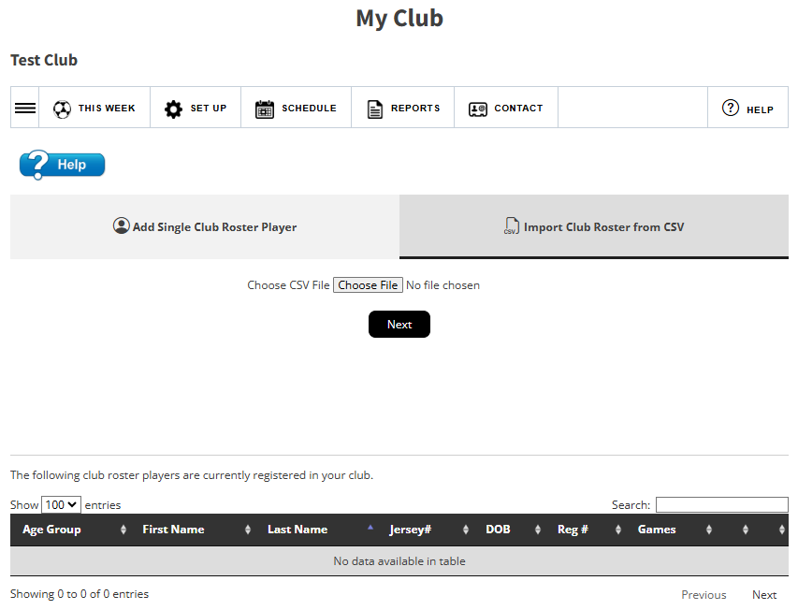
Adding Club Rosters
This can be done the same as house league players.
This can be done individually or through an CSV file.
To upload by CSV, click on the tab to Import
Choose the file from your computer. There is no template, but a sample is able on the next slide
Click Next.

Slide 25
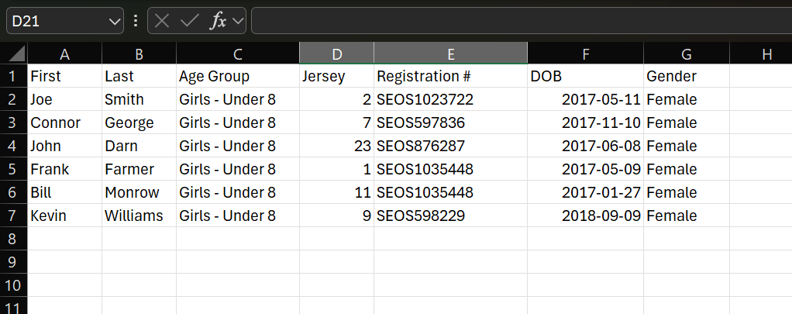
This is the ideal setting for your Club Roster upload.
Note that the Age group is required to determine the club roster the players are being added to.
If the headings do not match the upload requirements, you will need to choose the name from the drop-down menu on the next slide.

Slide 26
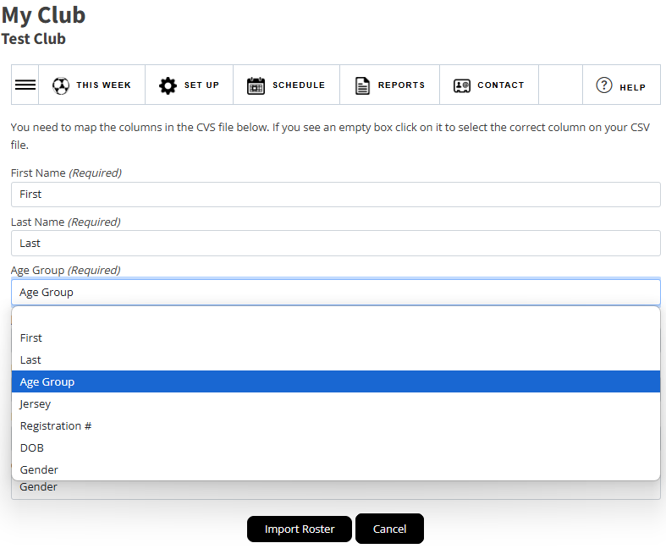
You will need to “map” the fields to match your spreadsheet.
If you are not importing details, you can choose the drop down to bypass option.
Each option has a drop-down list.
If the cell appears blank, choose the name that will appear in the drop down which matched the name on your spreadsheet.
i.e Spreadsheet has a column titled Age, heading on this page is called Age Group, choose Age from the drop down.
Click Import Roster to upload.

Slide 27
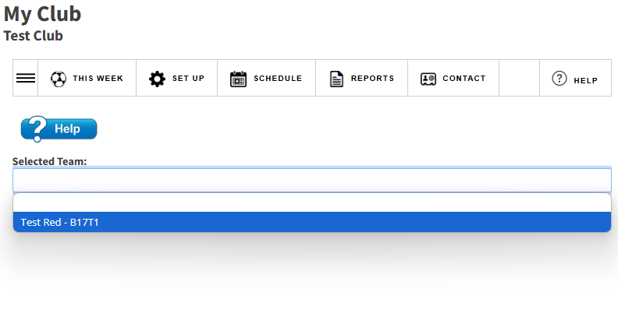
To upload teams U13 and above, go to Team Rosters (under Set Up)
Select your team from the drop-down menu

Slide 28
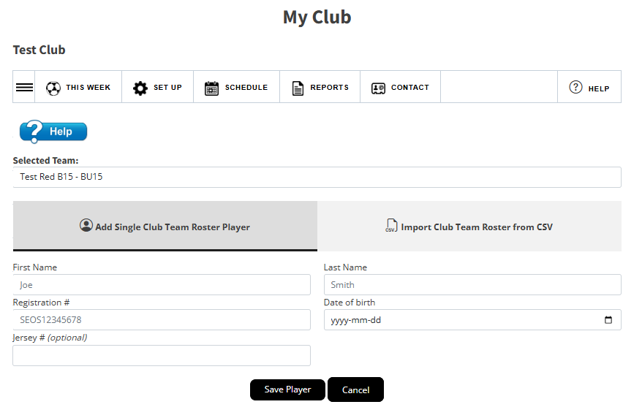
If using a CSV file, the team roster upload is the same format as the house league upload.
No Age Group is required.

Slide 29
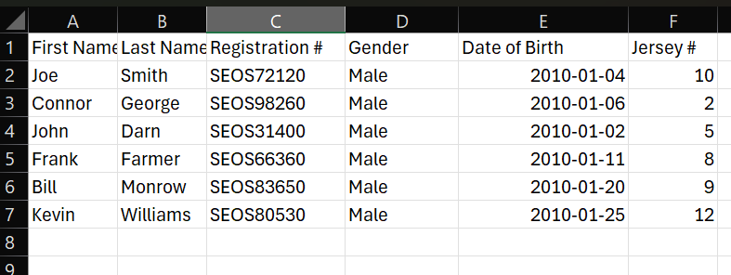
Team Roster upload sample

Slide 30
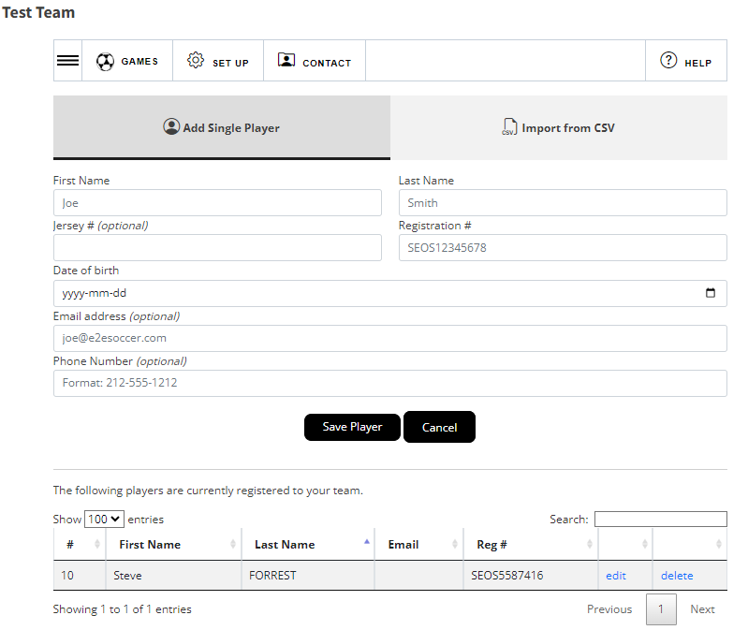
After players have been added
he or she will be listed in the table
below the buttons
If you need to edit or delete the
player use these links
Jersey numbers can be edited or added here as well.

Slide 31
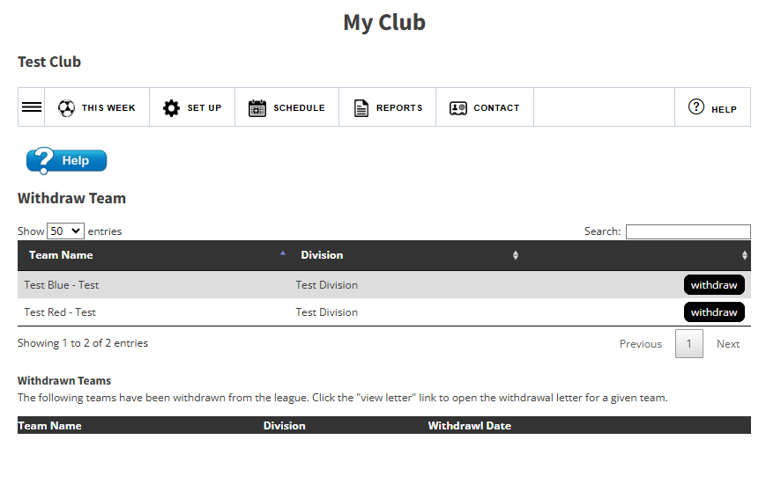
Prior to the schedule being completed, clubs can withdraw a team through the website.
Click on the withdraw button.

Slide 32
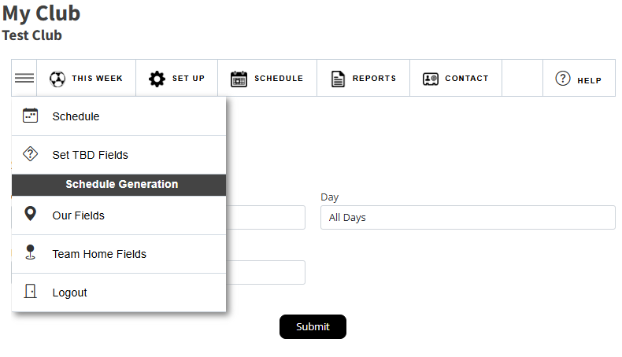
These tools manage the
schedule during the season
We have now moved to the ‘Schedule’ menu.
There are 2 sections in this menu
These tools are only used when the schedule is being generated

Slide 33
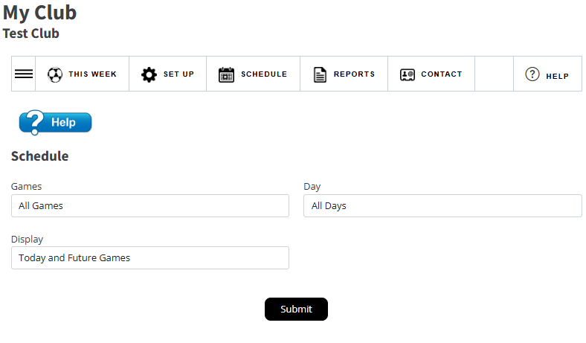
The first tool in this menu shows you the schedule for your club for the season

Slide 34
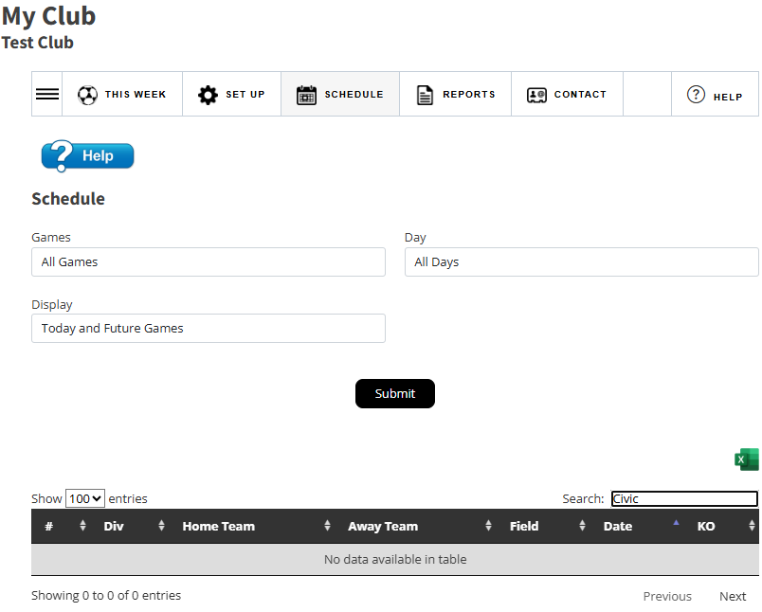
The first tool in this menu shows you the schedule for your club for the season
Use the Search box to filter your list

Slide 35
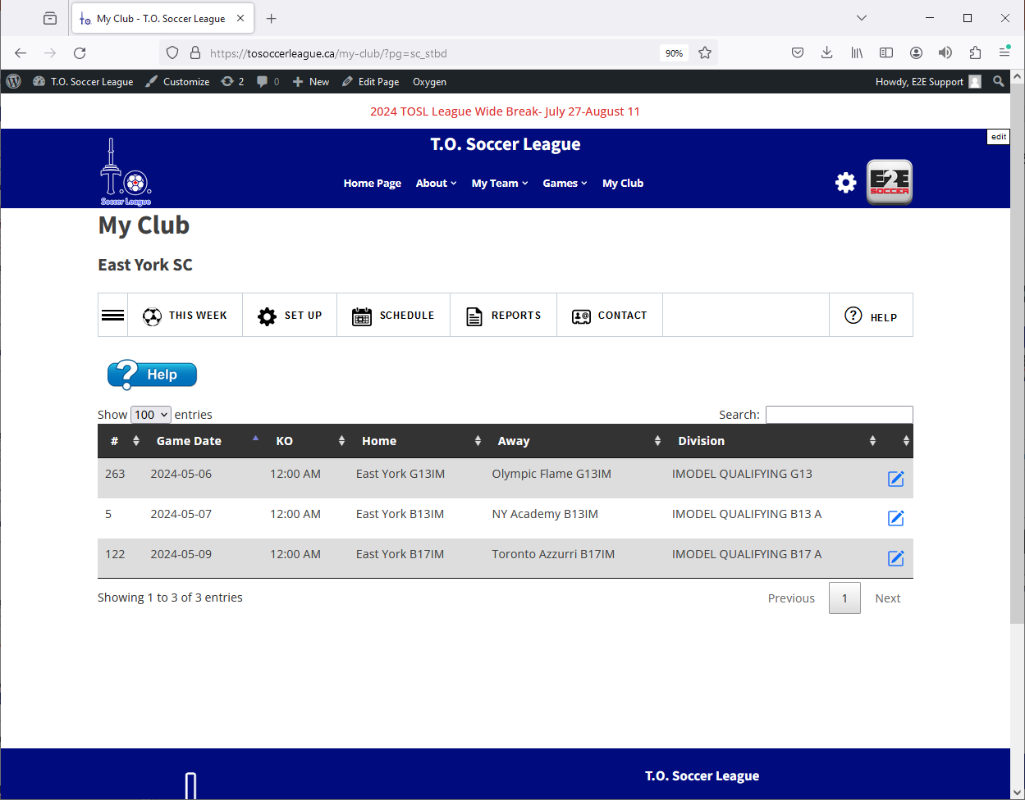
The next tool is ‘Set TBD field’ and allows you to set a field for a game where the field is currently set as ‘To be determined’
In this example there are 3 games listed where the field must be set.
Click the pencil icon to set the field and kick off.

Slide 36
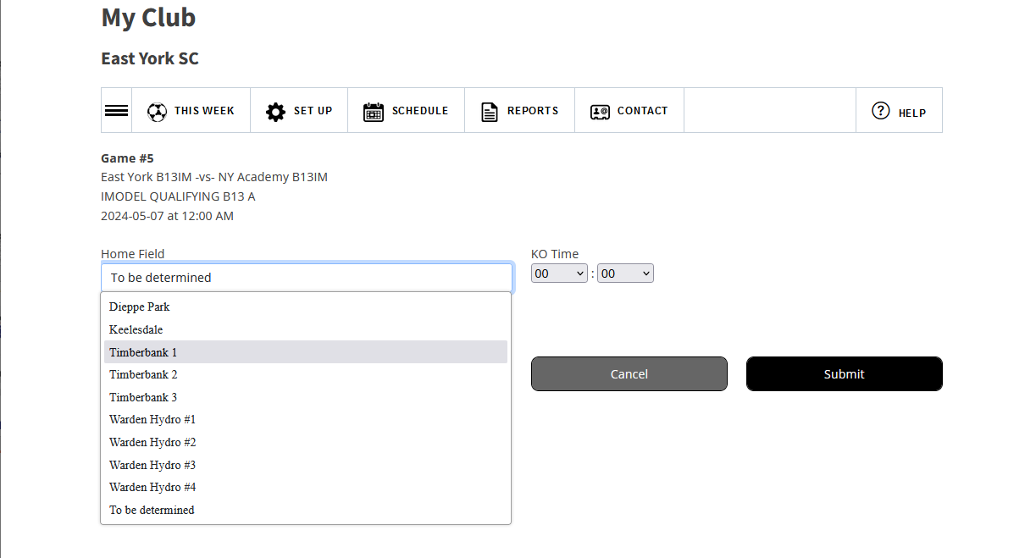
The select your field and kick off time for the game and click the ‘Submit’ button

Slide 37
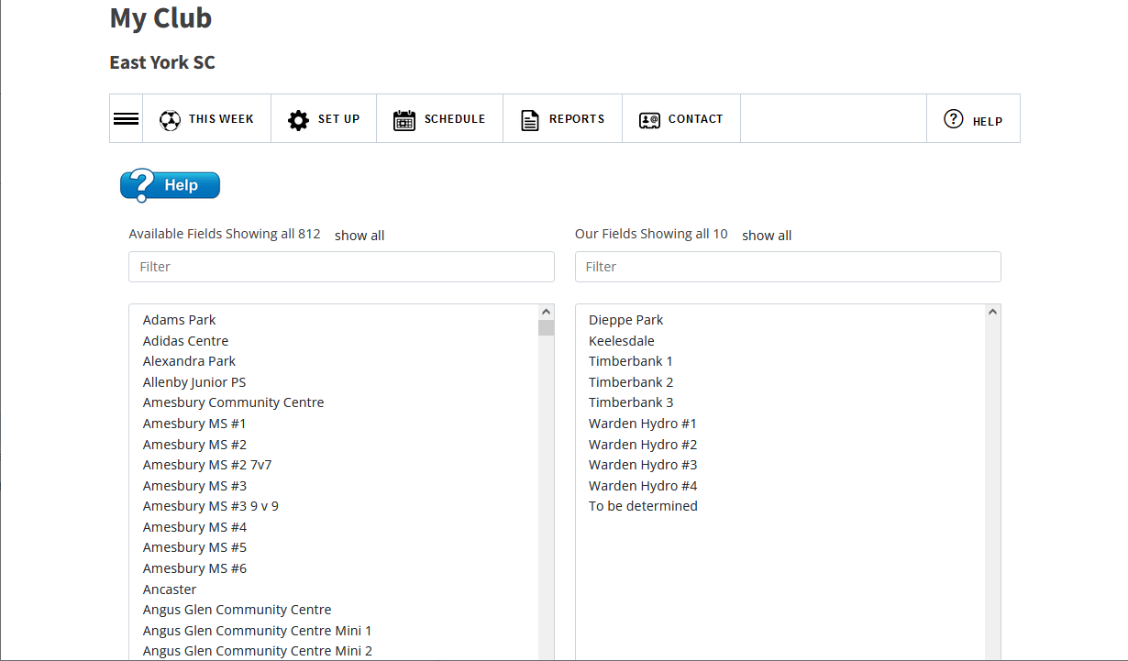
The next tool is the ‘Our fields’ tool.
This is where you select your fields from the available
fields for the league (left).
Click on a field in the left box and it will move to your list on the right.
You then use these fields to manage your schedule without the clutter of fields from other clubs.

Slide 38
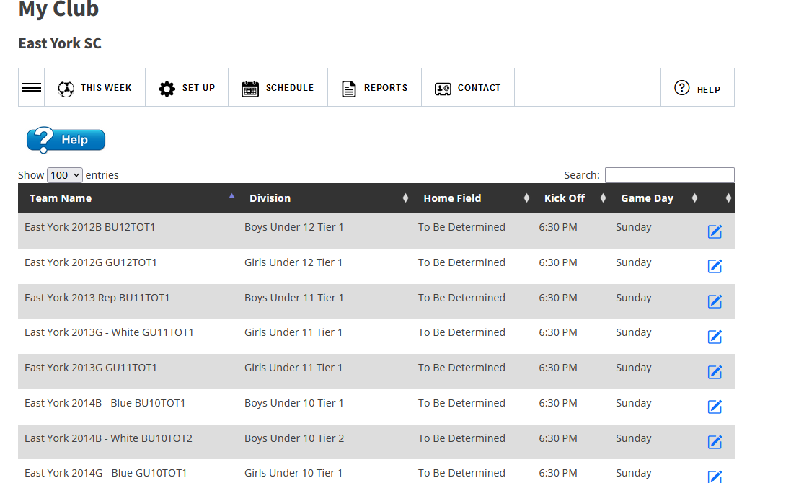
The next tool is the ‘Team Home fields.
This is where you set the home field for each team in your club
Click the pencil to set the field

Slide 39
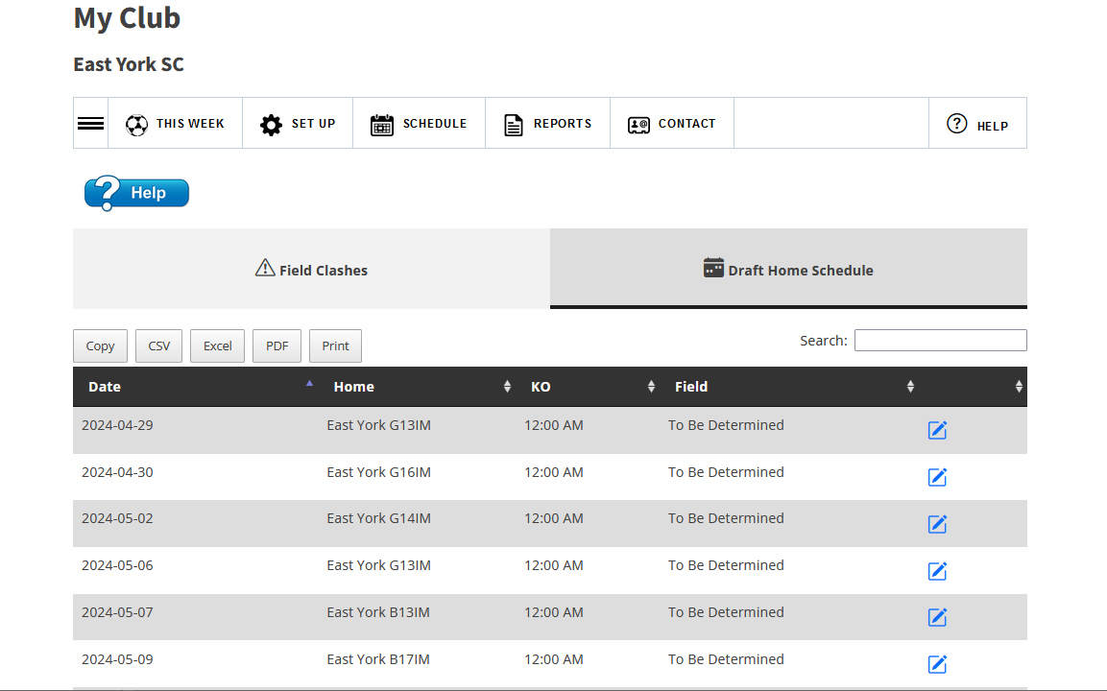
The final tool in this menu is the ‘Draft Schedule’ tool.
This is used for schedule generation where you can set your home fields before the
Schedule is published.
If there are clashes, they will appear on the Field Clash tab.

Slide 40
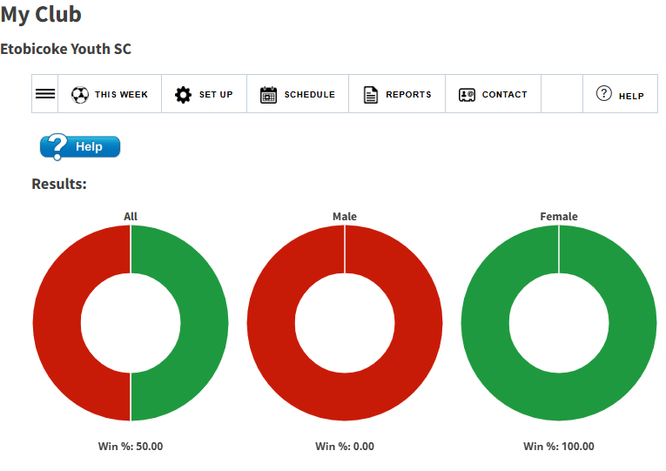
The next menu is the ‘Reports’ menu
The dashboard will show the results to date for all your teams.

Slide 41
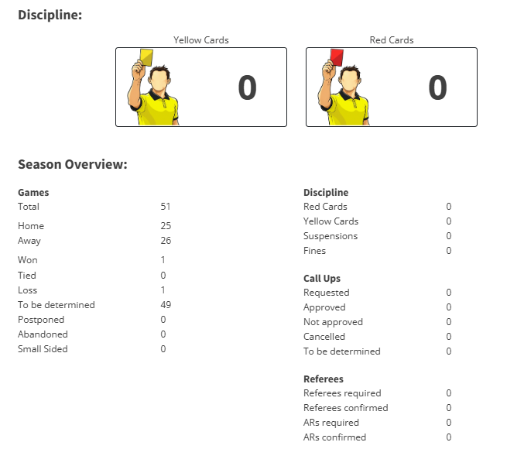
The Dashboard continues to show more information at a glance on how your club is doing.

Slide 42
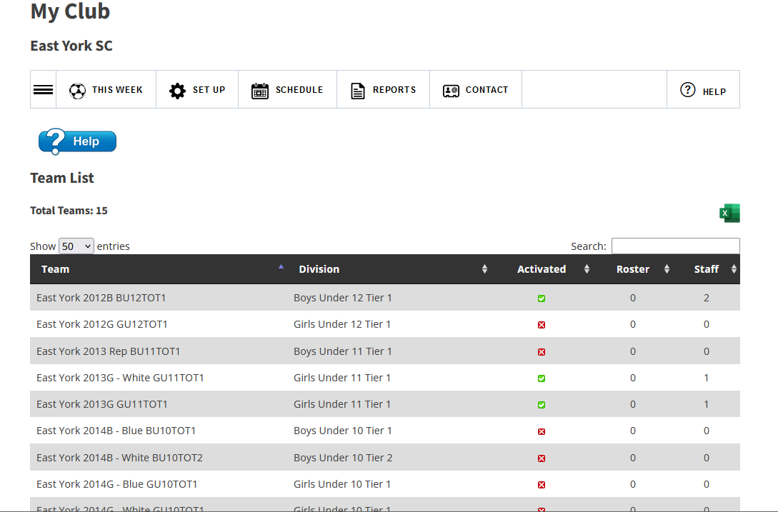
The tools in this section are reports to help you manage your club
Eg this one lists all your teams.

Slide 43
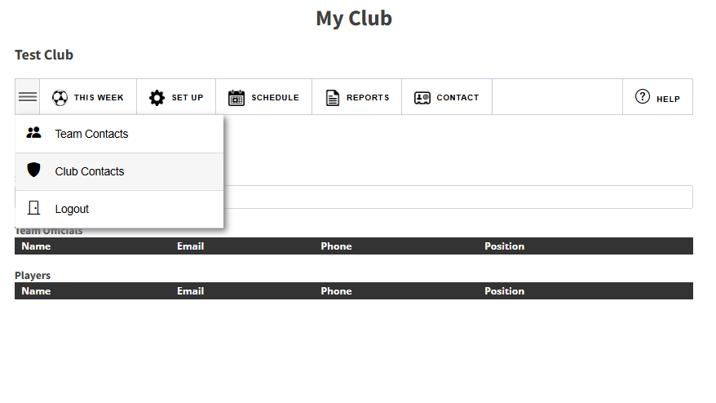
Contact Menu
Team officials are listed with emails, phone number and position they hold within the team.
Club contacts for the other club only also available.

