Slide 1
EOSL
Club Manual

Slide 2
About E2E Soccer
Company was founded in 2003
We are located in Ottawa
We provide IT solutions for the soccer community
Our products allow our customers to automate their operations in a cost effective manner
Our goal is to provide the customer with an end to end or E2E solution

Slide 3
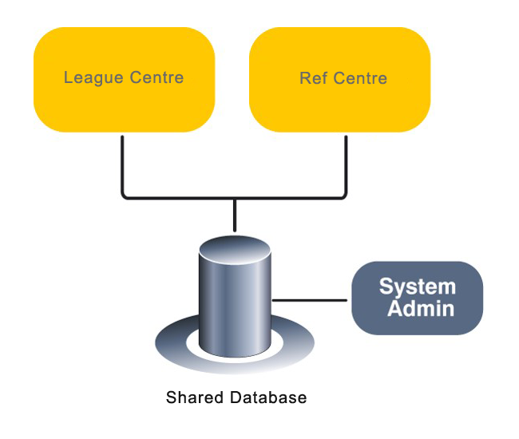
The EOSL solution

Slide 4
League management roles and responsibilities
League staff Club staff Team staff Players
Generate schedule
Review game sheets
Discipline management
Operate the league
Team oversight
Create club rosters
Approve call ups
Club management
Generate game sheets
Submit game reports
Request call ups
Manage reschedules
Read only

Slide 5
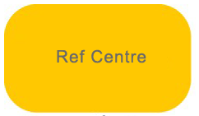
Referee management roles and responsibilities
League staff Club staff Assigner Referees
Referee oversight
Pay referees
Referee oversight
Pay referees
Assign referees
Support referees
Accept game offers
Submit game reports
Submit discipline
Upload game sheets

Slide 6
Club staff log into the club module here

Slide 7
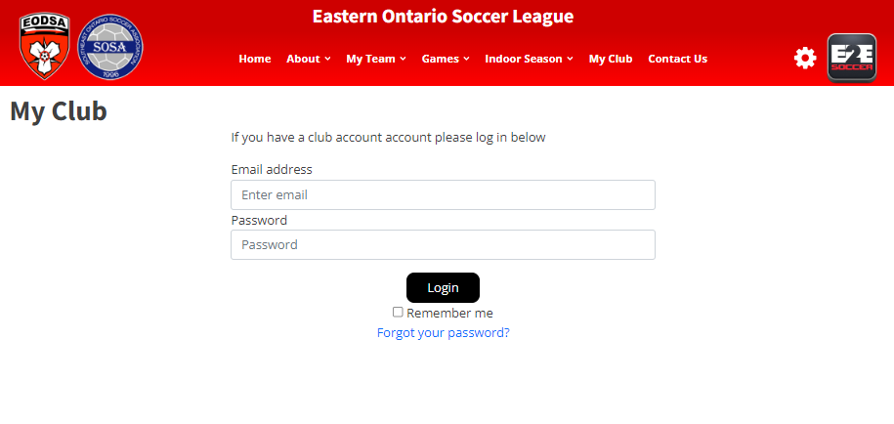
Log in using the email address and password that you have been given.
Use the “Forgot you password?” to reset your password

Slide 8
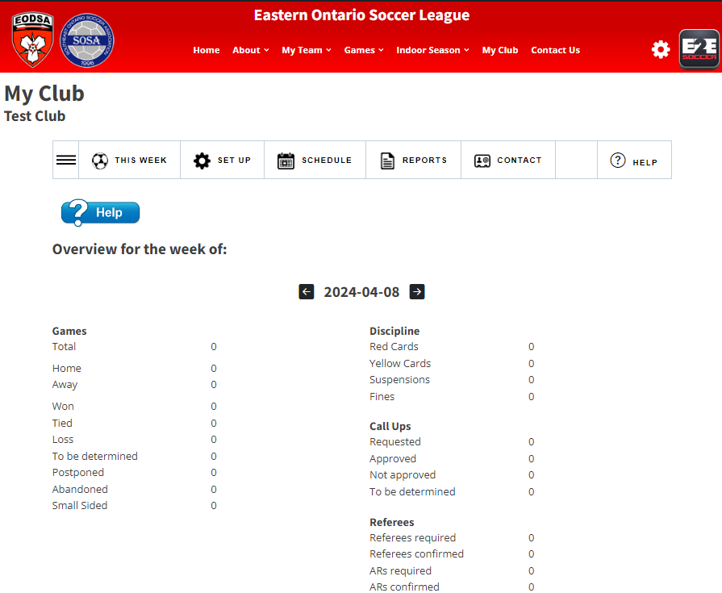
Your club
name
The club module
has 5 menus

Slide 9
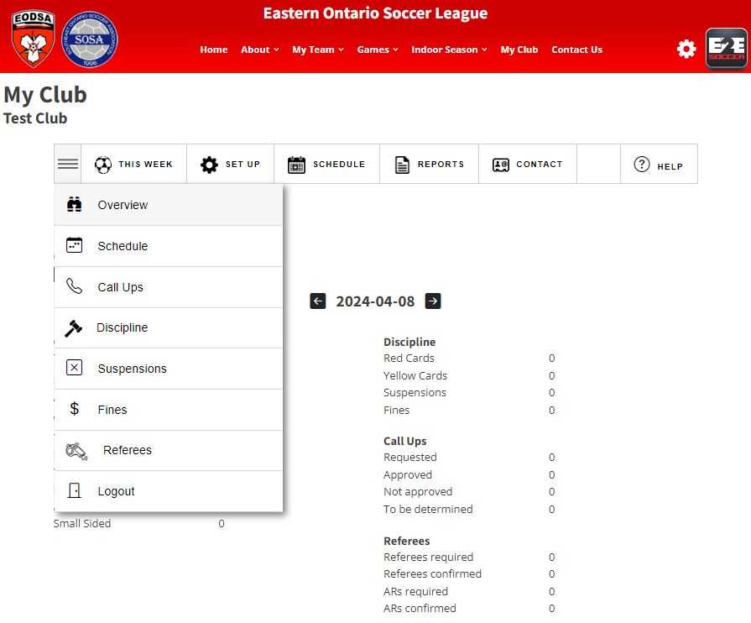
Use the 3
bars to see
the tools in each menu

Slide 10
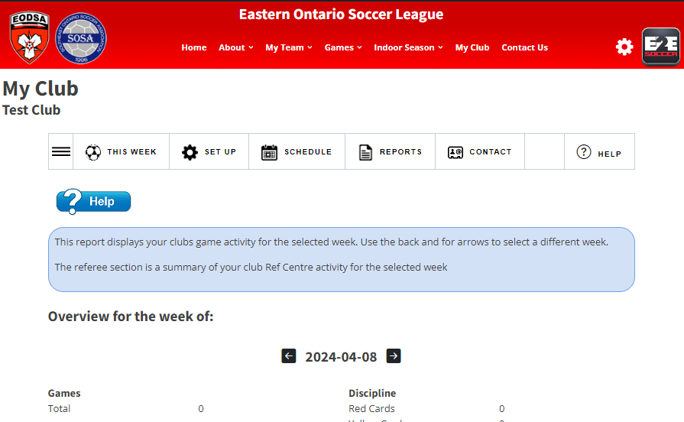
Click the Help icon for online assistance. A tool tip will appear.
Click the Help icon a second time and the tool tip will disappear.

Slide 11
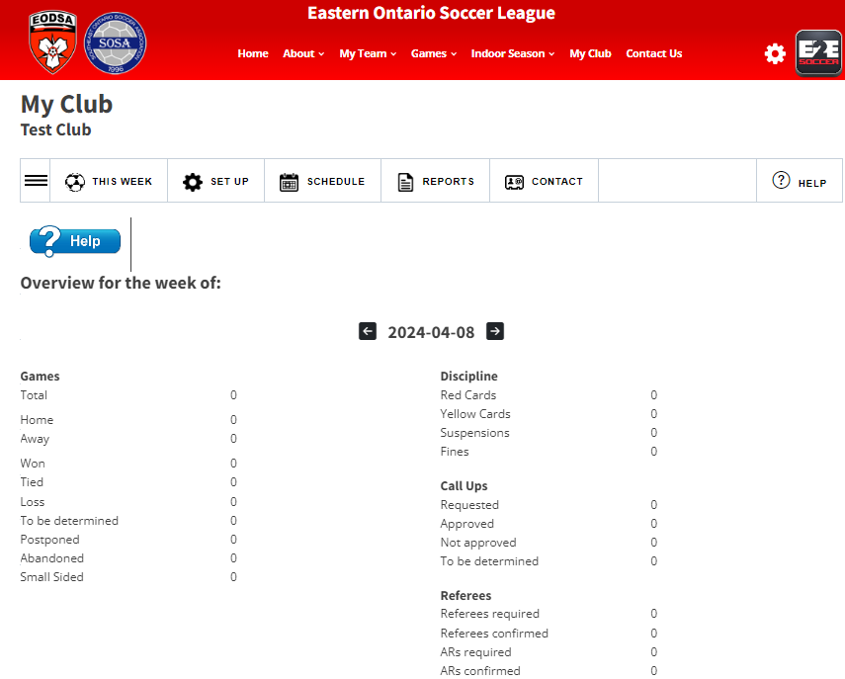
Your landing menu will be ‘This Week’
The tools in this menu report on you club for the selected week
Your landing page is “Overview for the week”. Its shows you statistics for this weeks games.
Use the back and for arrows on the week to move to another week.

Slide 12
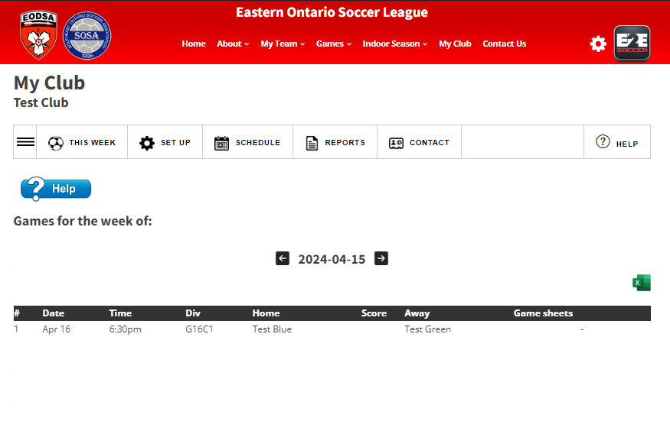
Games for the week for all teams within the club are listed.

Slide 13
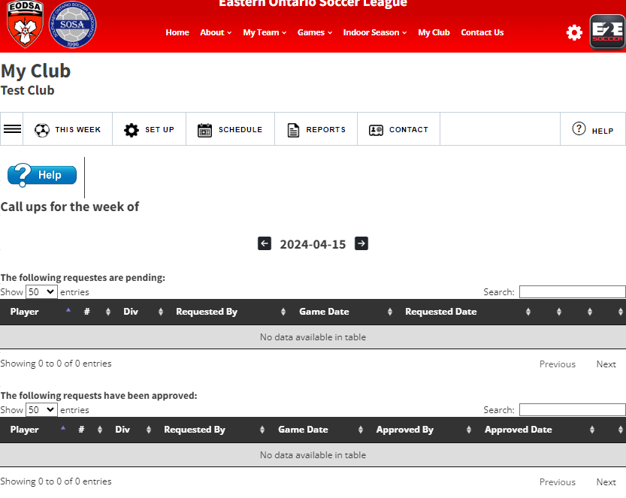
View your call ups for the week.

Slide 14
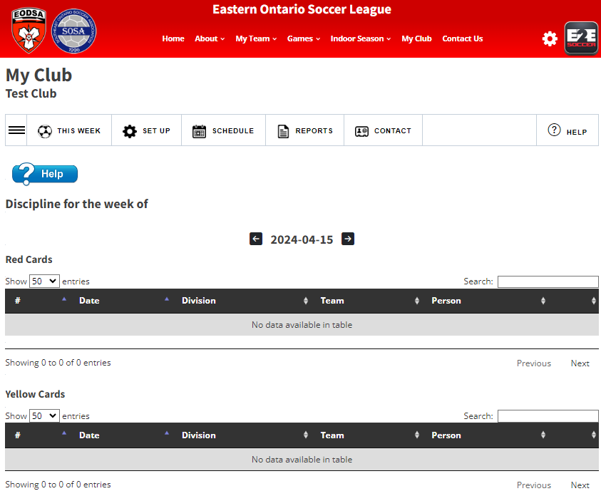
View your discipline for the week.

Slide 15
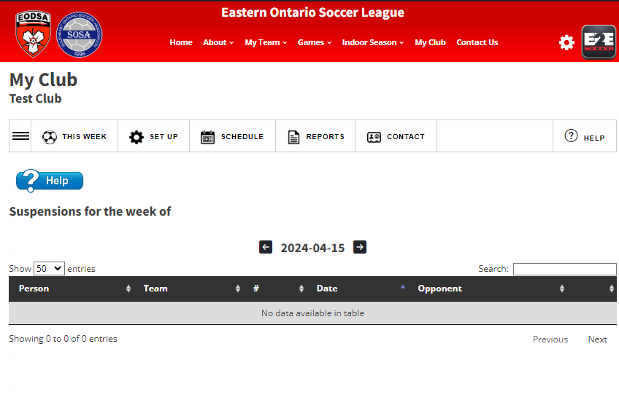
View who is suspended this week.

Slide 16
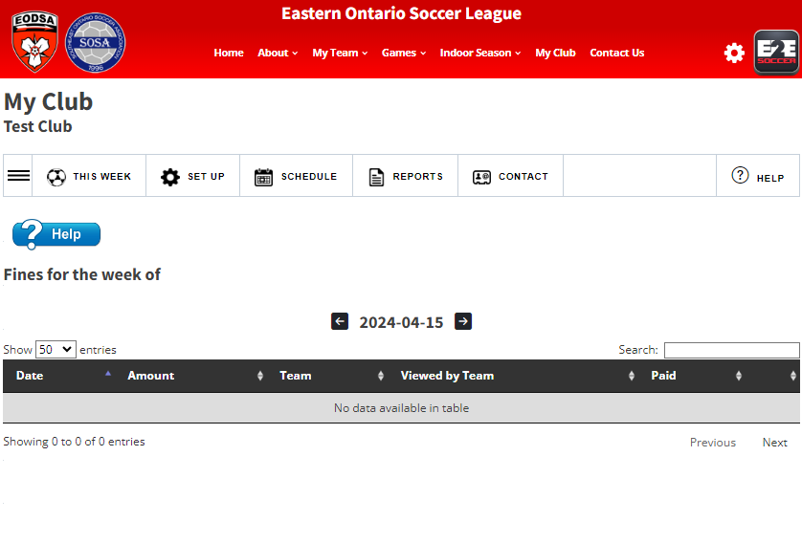
View your fines from this week.

Slide 17
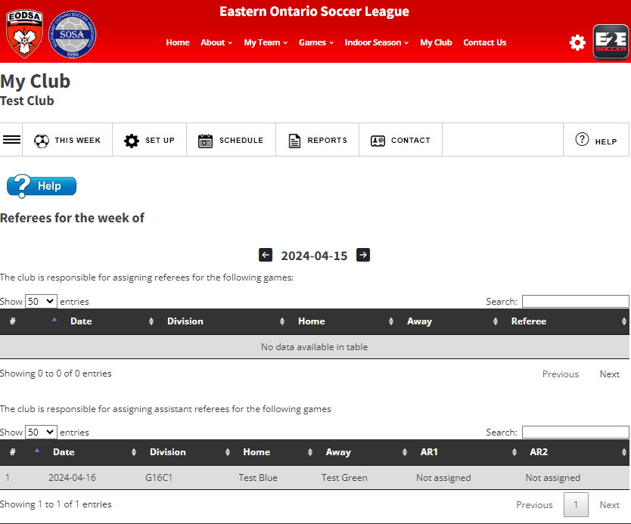
View your referees for the week.
This is read from Ref Centre.

Slide 18
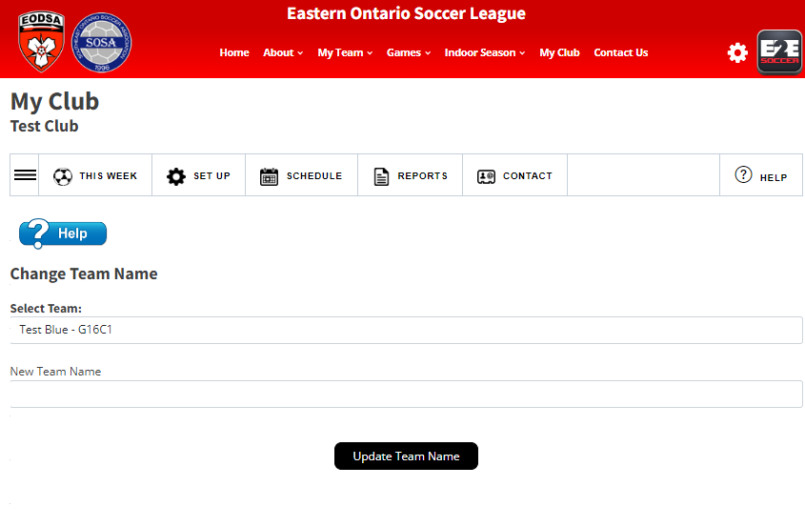
Setup Menu
Now we move to the Set Up menu
The 1st tool is changing a teams name
The Club has the option to adjust team names but please consult with EOSL first to make sure you are following EOSL naming policy

Slide 19
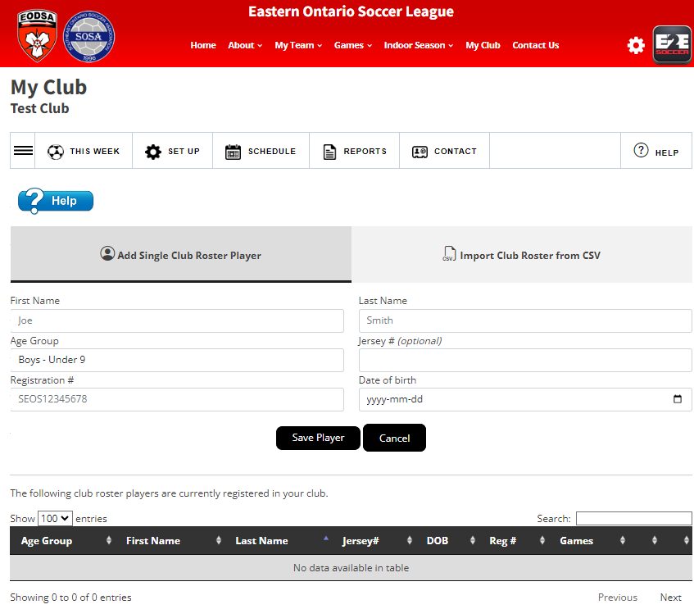
Adding club rosters
Add players with a CSV file or a single player using the Club Rosters tool

Slide 20
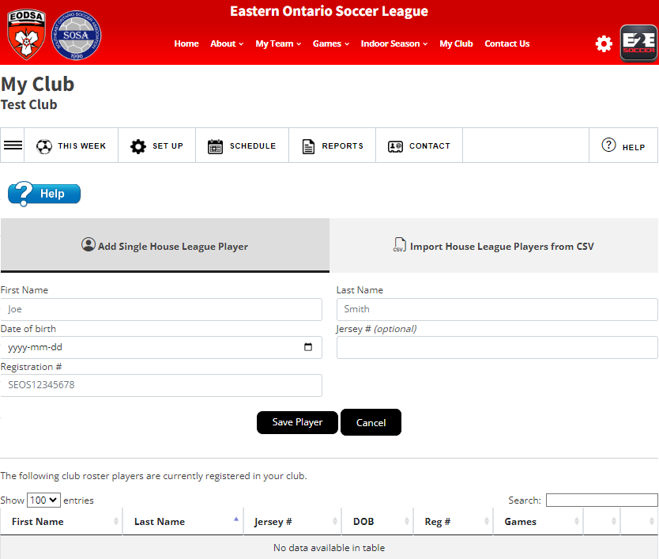
Adding house league players
Clubs can add house league players who can then be called up to a full field team within their club.
This can be done individually or through an CSV file.

Slide 21
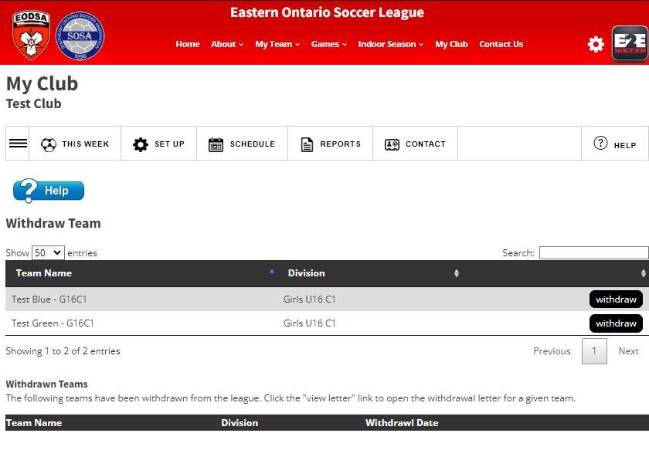
Prior to the schedule being completed, clubs can withdraw a team through the website.
Click on the withdraw button.

Slide 22
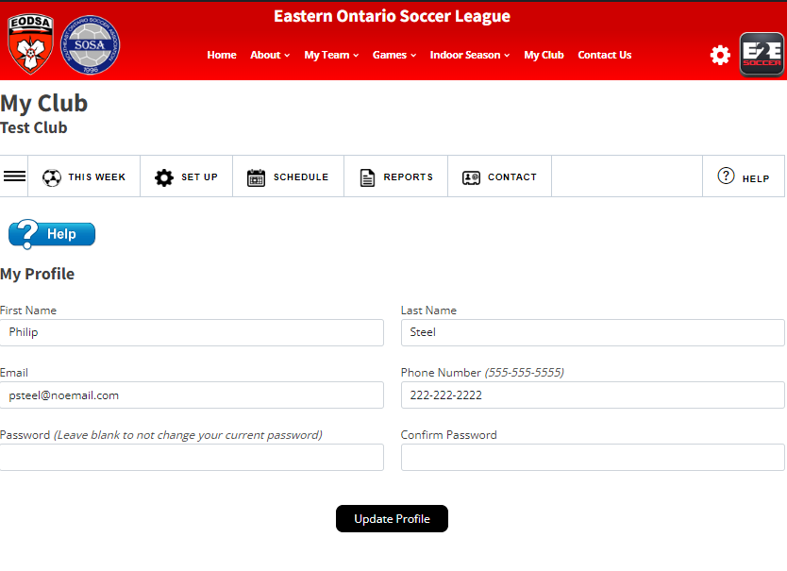
Manage your profile on the My Profile page.

Slide 23
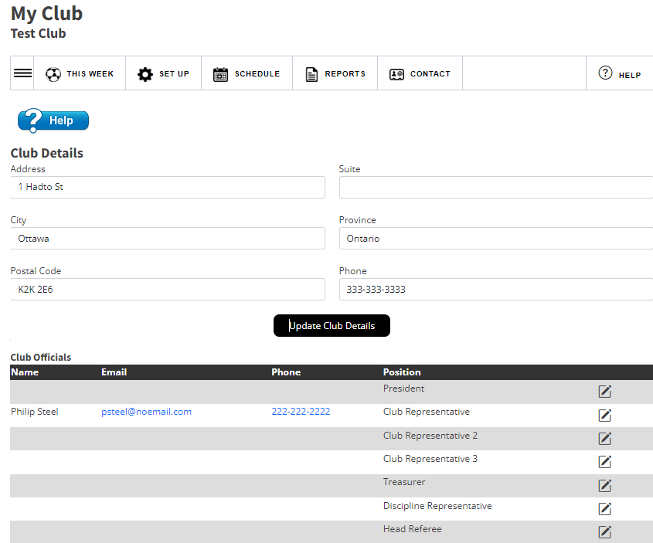
Manage your club profile and club officials on the Club Details page.
Use the pencil icon to update a club official

Slide 24
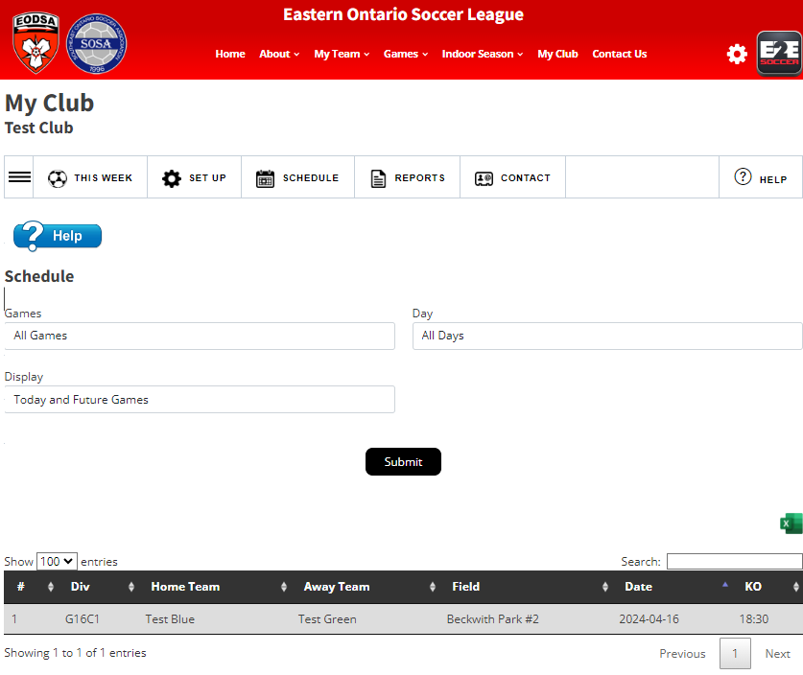
Schedule Menu
Clubs can view their schedule for the season
Click here to export to Excel

Slide 25
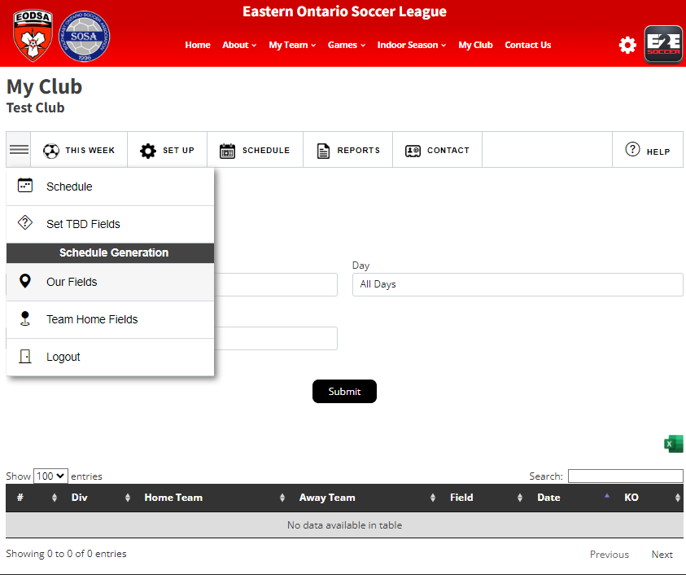
Before you can modify your TBD games, you need to add your fields.
Click on Our Fields

Slide 26
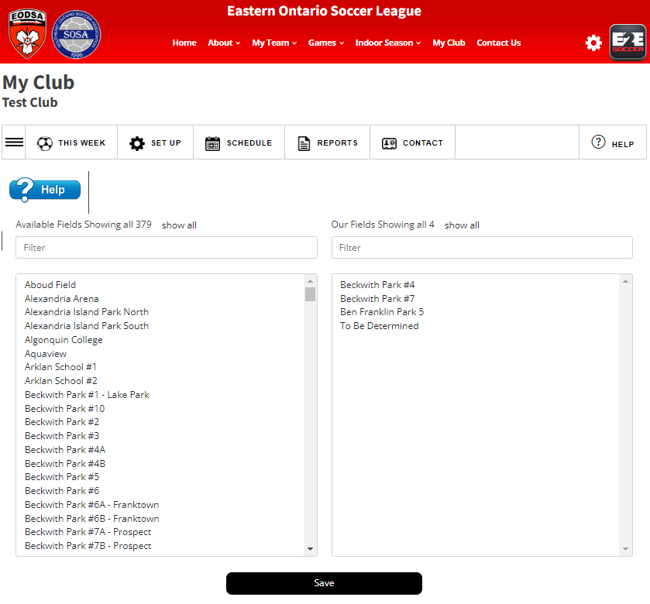
All fields within the EODSA are listed.
Click on the field name to move it over to your field list.
You can type in your field name to find them quickly.
Be sure to Save your field selections.

Slide 27
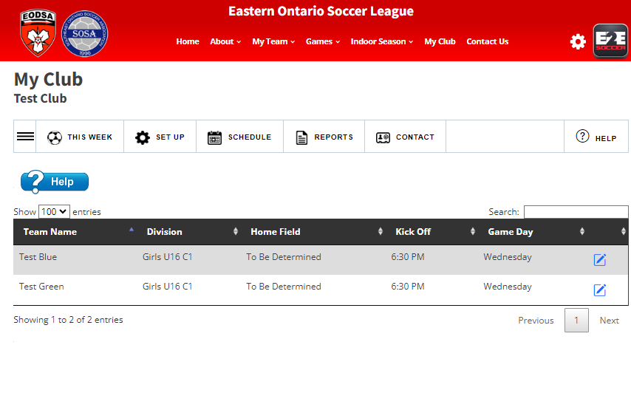
You can set a teams home field by clicking the pencil. All games will be updated to this field and kick off time.

Slide 28
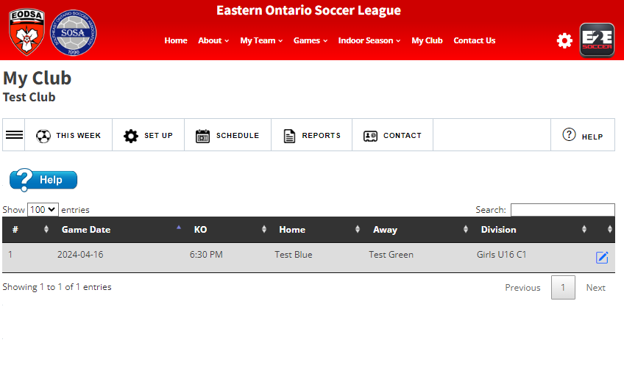
To edit an individual game listed as TBD, click on the pencil.

Slide 29
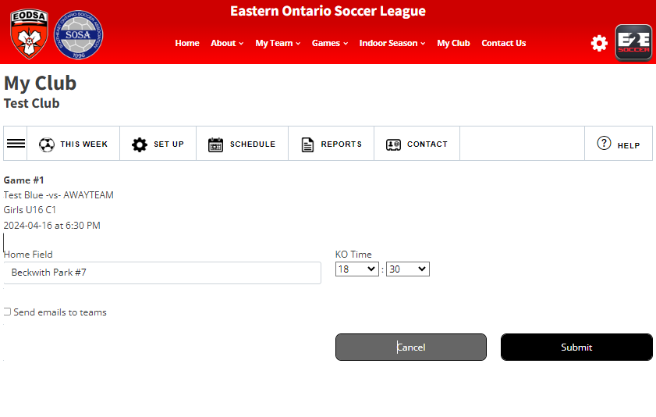
Choose the field from your list and change the kick off if required.
You have the ability to email both teams by checking the box.
Click submit to make the update.

Slide 30
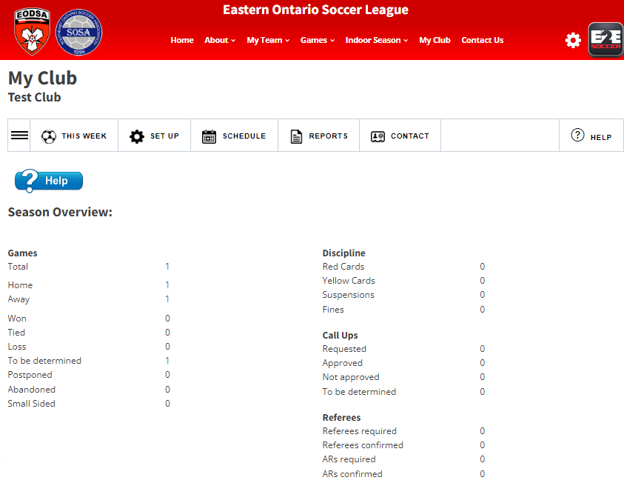
Reports Menu
The reports menu provides some helpful reports to assist the clubs with overseeing their teams.
The season overview provides a summary of games, discipline, call ups and referees.

Slide 31
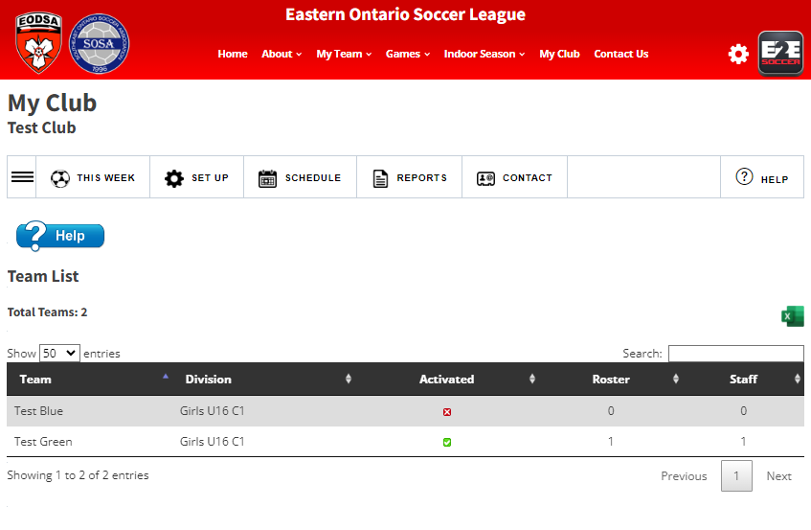
Team list shows all teams within the club and which division they are playing in.
Teams activated, roster numbers (full sided only) and number of staff activated on the team are listed.

Slide 32
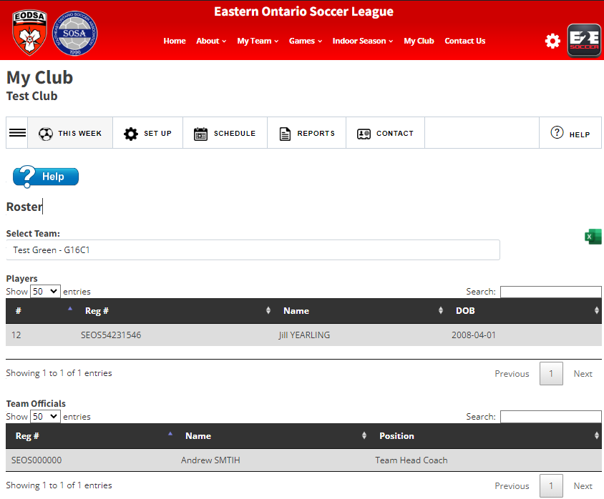
Rosters for full field teams can be seen on the Roster tool

Slide 33
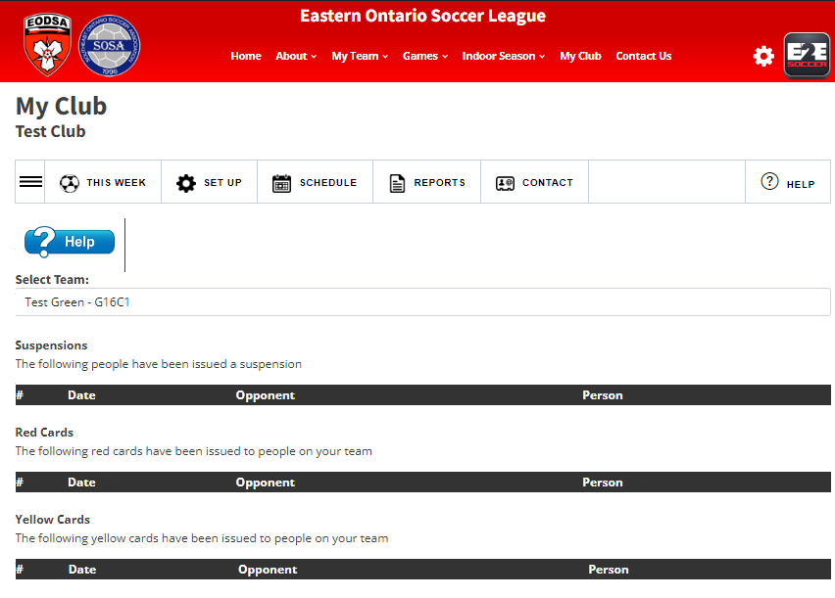
Team discipline per team is listed in the discipline report

Slide 34
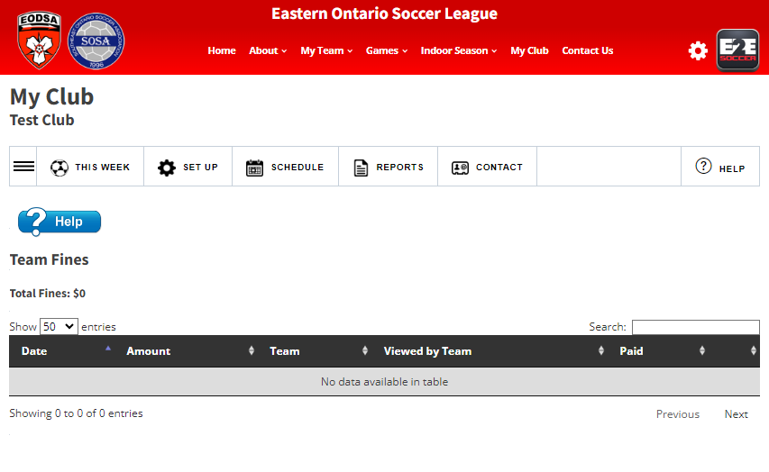
Team fines are listed.

Slide 35
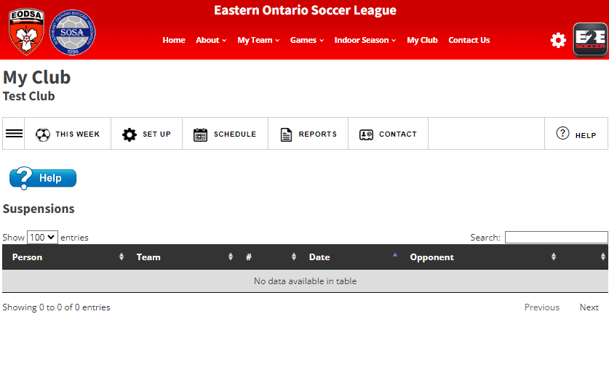
Suspensions are listed for all players and staff within the club.

Slide 36
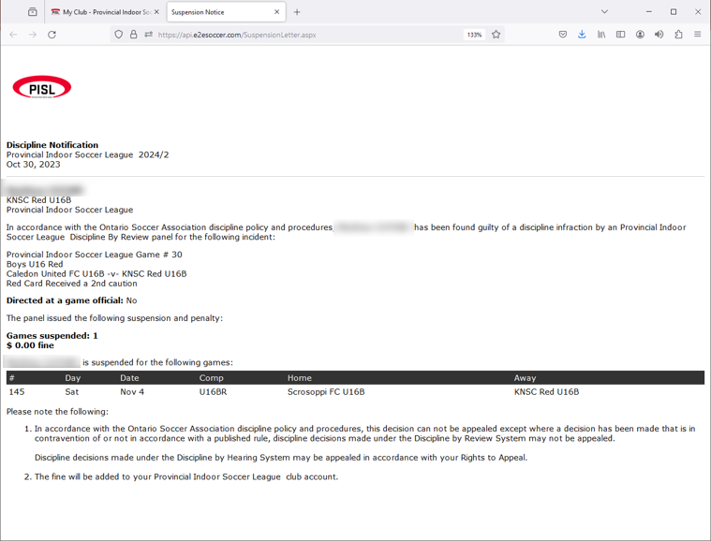
You can view the
suspension letter

Slide 37
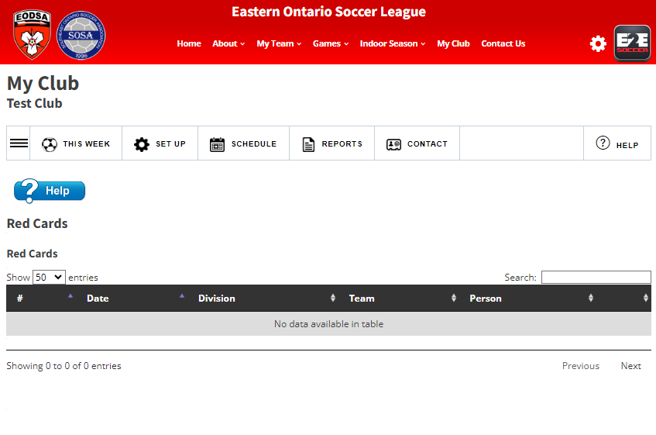
Red cards received by players or team staff within the club are listed.
Clubs have the ability to read the card.

Slide 38
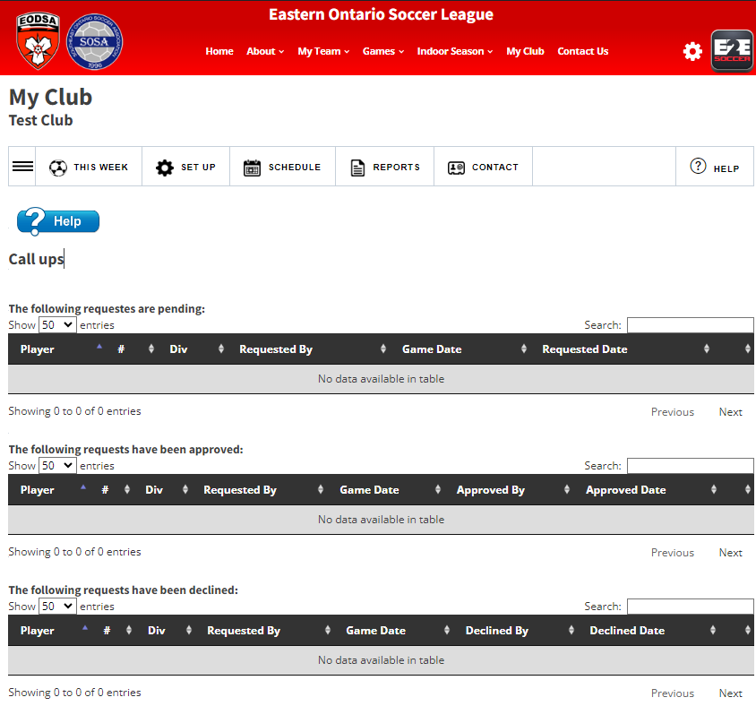
Call ups requested by teams will be listed here.
Clubs must approve or decline the call up.

Slide 39
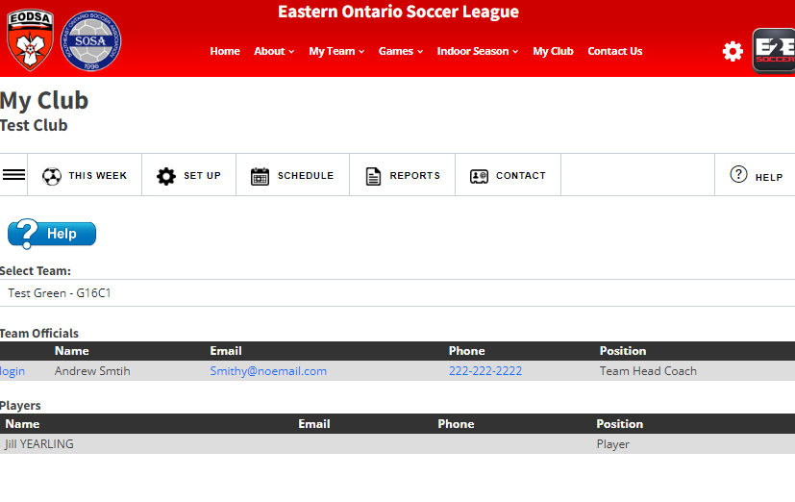
Contact Menu
Team officials are listed with emails, phone number and position they hold within the team.

Slide 40
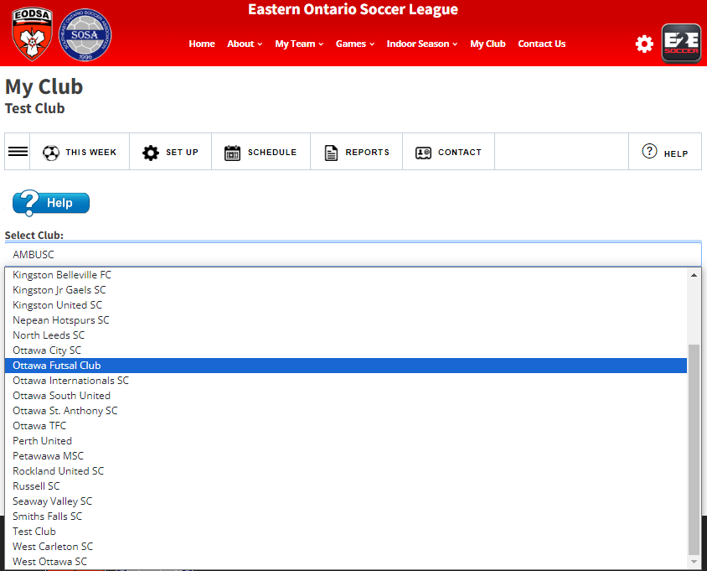
You can also look
up the contact
information for
staff from other
clubs.

