Slide 1


Team Managers & Coaches
Pre-Season Meeting
May 6th & May 8th, 2024

Slide 2
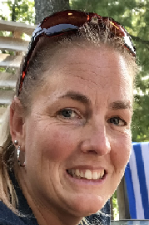
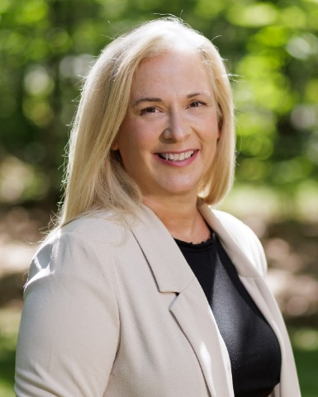
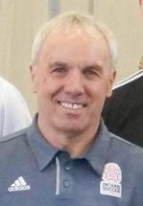
Introductions
Dawn Dinsdale
EOSL
League Administrator
Vicki Lowe
EODSA
Executive Director
David Smith
EODSA
Referee Co-Ordinator

Slide 3

Acronyms
TRR - Team Roster Report. This report comes from your Club and must go to all games It is an approved list of players and Team Officials
EOSL - East Ontario Soccer League
OSCAR - Also called Sports Engine, it is Ontario Soccer’s management and registration system
SEOS - Sports Engine Operating System - only used in reference to registration numbers (ie SEOS123456)

Slide 4

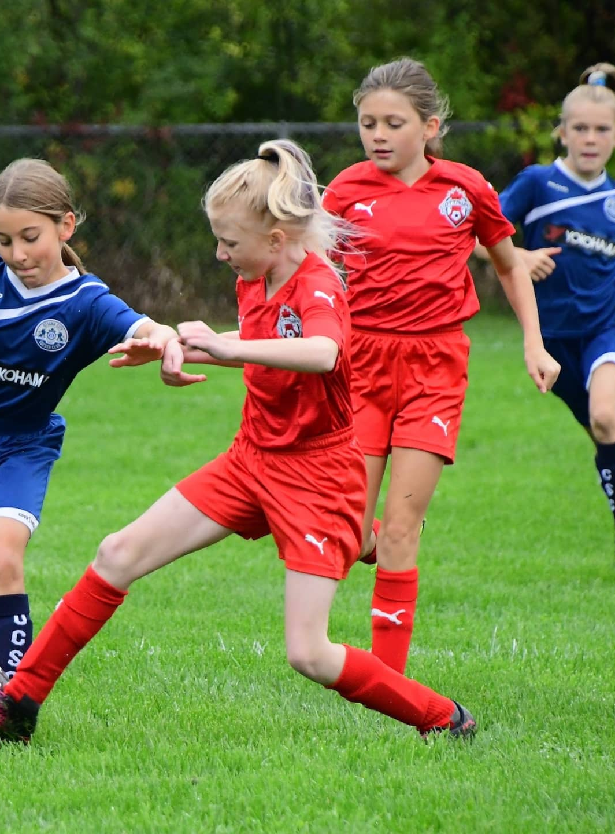
The 2024 EOSL season
Week of May 20th Season starts
Week of July 22nd Start of two-week mid season break
Week of August 5th Season resumes
Week of August 18th Under 18 season concludes
Week of September 2nd Last week of Summer Season
Week of September 29th All games to be played

Slide 5
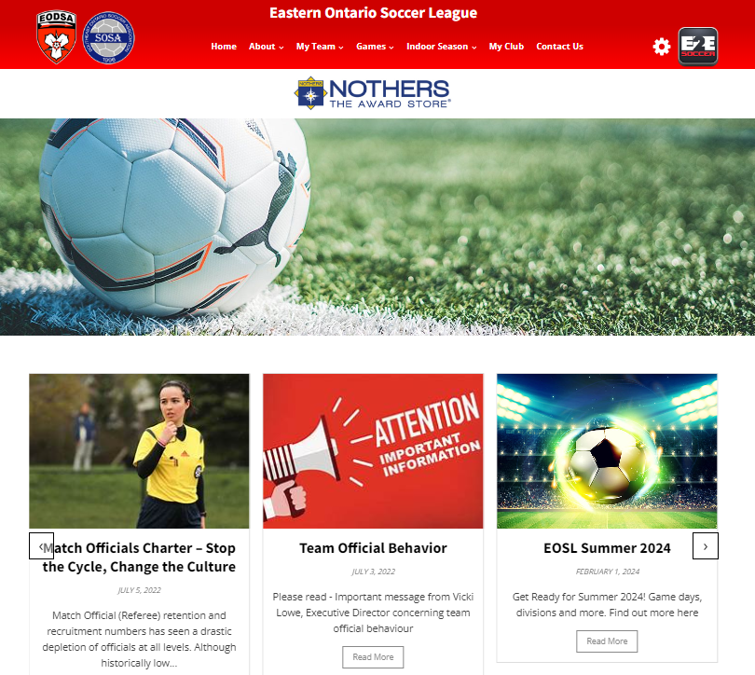
League Website Information www.eosl.ca
Discipline - https://eosl.ca/discipline/
Rules - https://eosl.ca/league-rules-2/
Policies - https://eosl.ca/policies/
FAQ - https://eosl.ca/coach-manager-faq/

Slide 6
3.04 Maximum 20 players
3.05 The deadline for placing a player on a team roster is July 31st of each year
6.03 The names of players and team officials who are not present at the game must be crossed out on the game sheet. All players and team officials, including call-ups, whose names appear on the game sheet that are not crossed out, will be deemed to have played or participated in the game, and could be subject to disciplinary action based on being deemed to have participated in the game
6.04 When a game sheet cannot be printed from the LMS due to technical difficulties, the team will inform the EOSL by email that the team was unable to print the game sheet. Notice of the difficulty must be received prior to the game start time. If notice is received after the game start time, the team's Club will be subject to the applicable fine as per the published EOSL Fees and Fines Schedule
7.03 No protest pertaining to the eligibility of a player will be entertained if ID is not checked prior to the game. For further clarity, a notation must be made on the game sheet that the game is being played under protest.

Slide 7
11.02 Only the players listed on the game sheet and a maximum of 4 team officials are permitted to be in the designated technical area. All substitute players and team officials will confine themselves to their designated technical area
11.05 No coach or team official may enter the field of play at any time without the prior approval of the Referee
11.08 Clubs and team officials are always fully responsible, at all times, for the conduct of their players, other team officials and spectators, at and in the vicinity of any game in which their team participates, including the parking lot
12.03 If both teams jointly agree not to play a scheduled game, then each team will receive a loss (with no score) and nil points from that game and the teams will be subject to disciplinary action

Slide 8
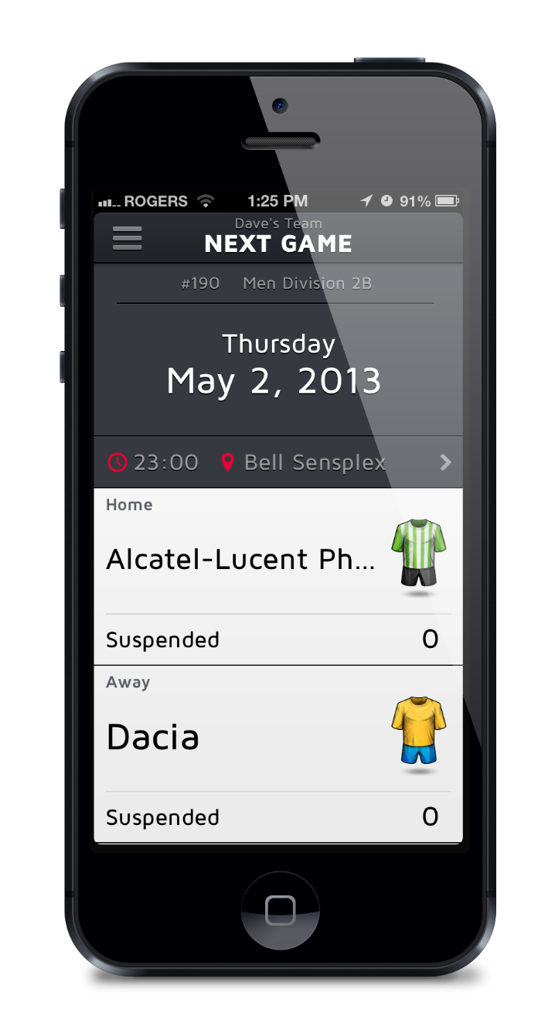
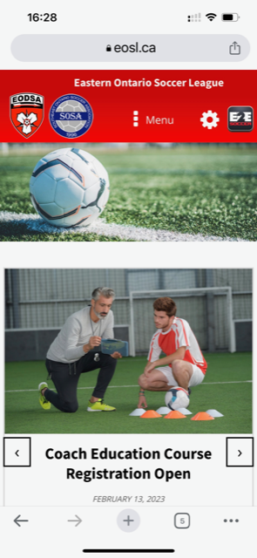
Website – Mobile Friendly
Your 2024 website is mobile friendly
The site will allow us to keep
you posted of league and other
soccer news
There is an app is called E2E Soccer League Centre

Slide 9
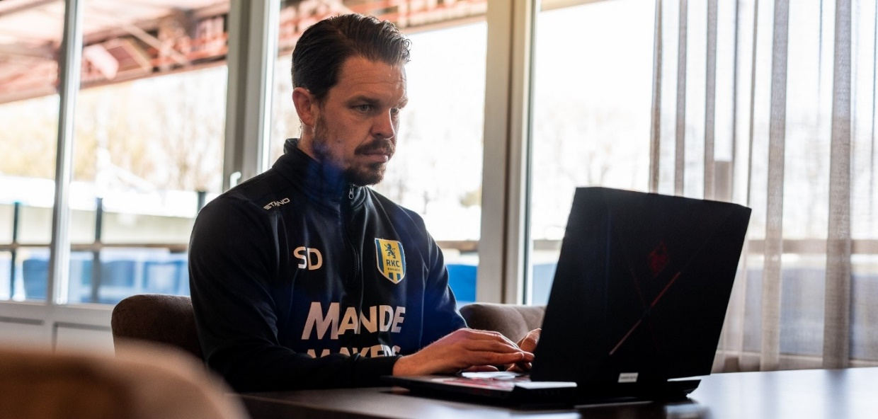
Setting up your team management account
These tasks need to be done before the start of the season
Every coach and team manager needs to perform an activation process
Your name won’t appear on game sheets until you have done this

Slide 10

Go to the My Team menu and
select Team Management

Slide 11
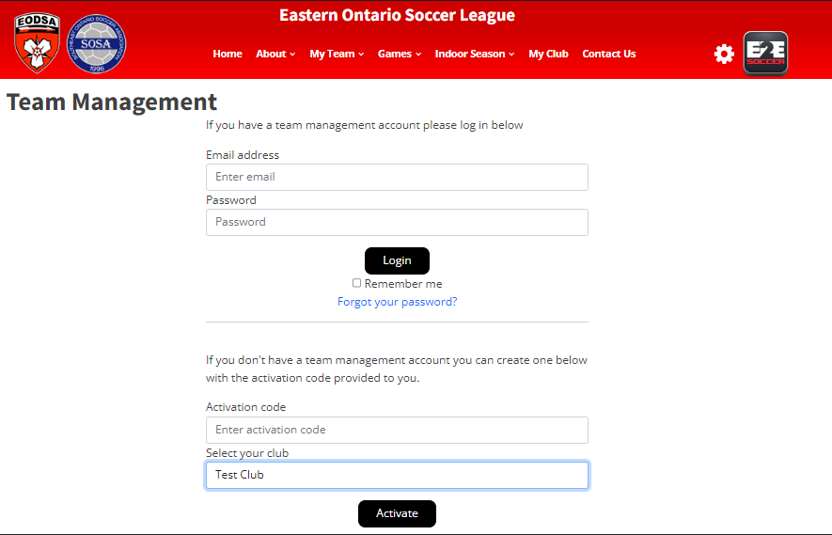
Activate here
Choose your Club name from the drop-down menu, then click activate.
Activation code will only be provided to the club.
Please contact your club.

Slide 12
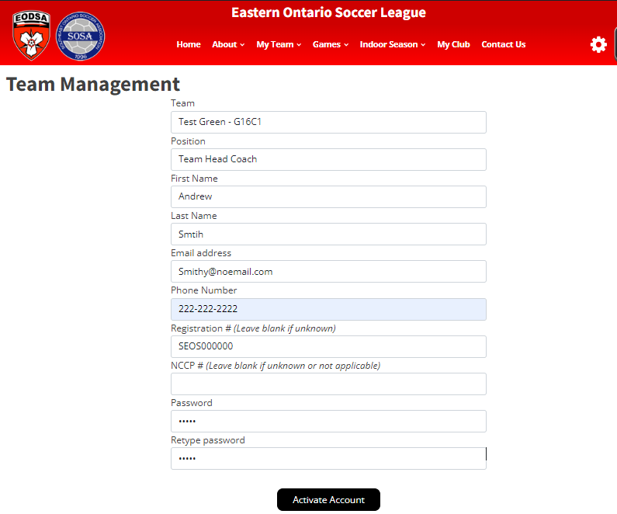
Make sure that you select the
correct team
Fill in the form as requested then
click the ‘Activate Account’ button

Slide 13
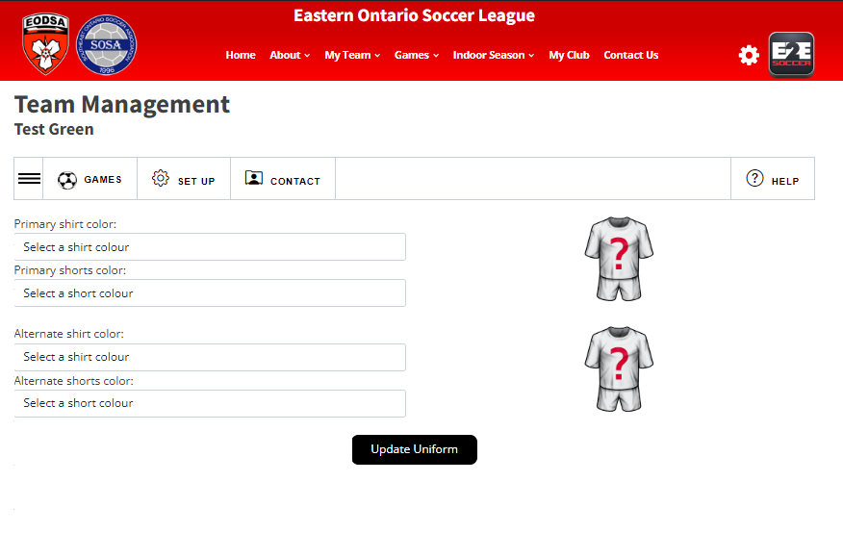
You will now be taken to the Team Management module and prompted to enter your shirt colours and click “Update Uniform”
If you don’t do this step your account won’t be created
*If you are involved with more than 1 team, you need to activate each account using a unique password
Notes:
Dawn – question, do all team officials enter uniform colours or just the first one. What if they enter different info?

Slide 14
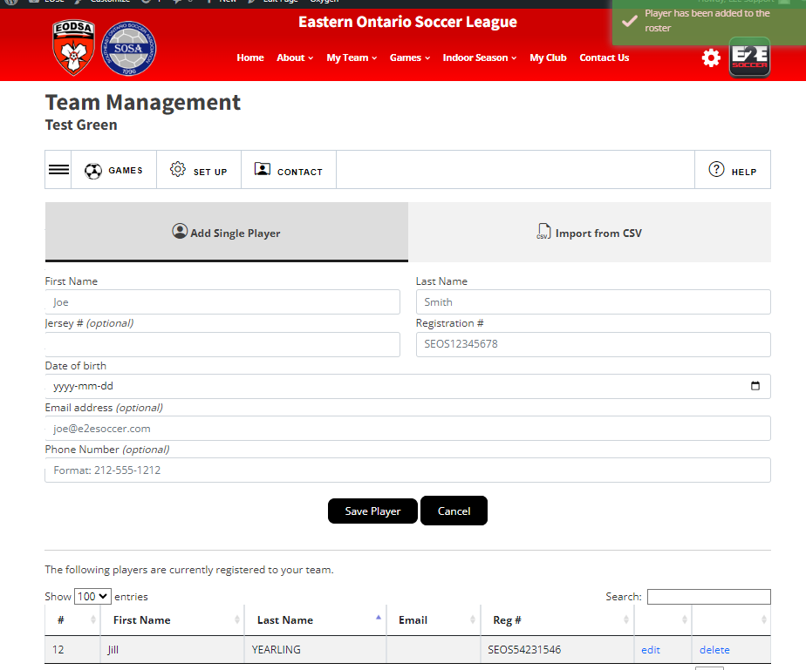
U9 to U12 teams – your Club will upload your player roster
U13 to U18 teams – the League will upload your player roster once it all players and coaches are fully registered by your Club and the roster is approved by the District.
IF you need to add players, you can do so in this screen to add them individually

Slide 15
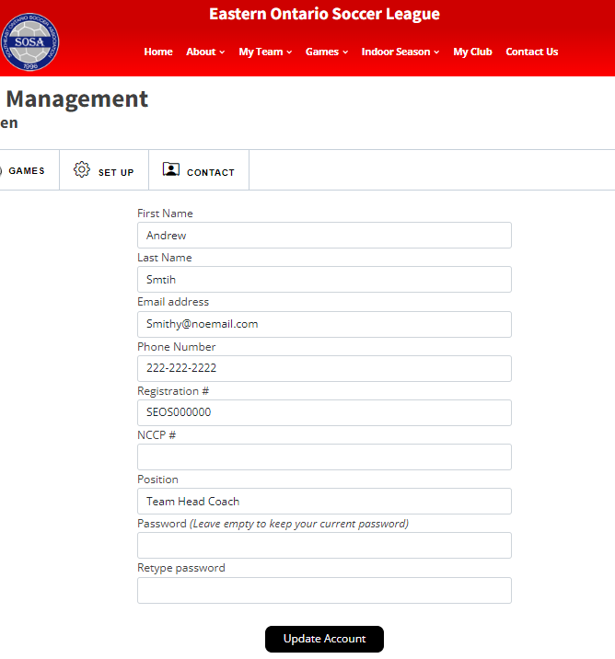
If you failed to enter your SEOS number during the activation process, you can update it later under Set Up/My Account.
SEOS numbers MUST be entered and appear on the game sheets.
Your SEOS number is on the TRR, on your Sports Engine account, and your Club will know it

Slide 16
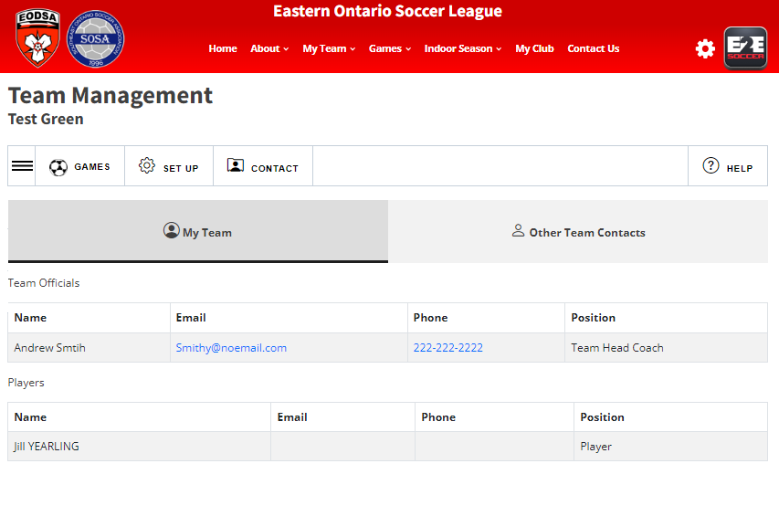
When you click on Contact, there are 2 tabs:
  My Team
  Other Team Contacts
Please use this when contacting your team or opponents.
Please contact your Club if you need assistance setting up your team. They will contact the league if they can’t help you.

Slide 17
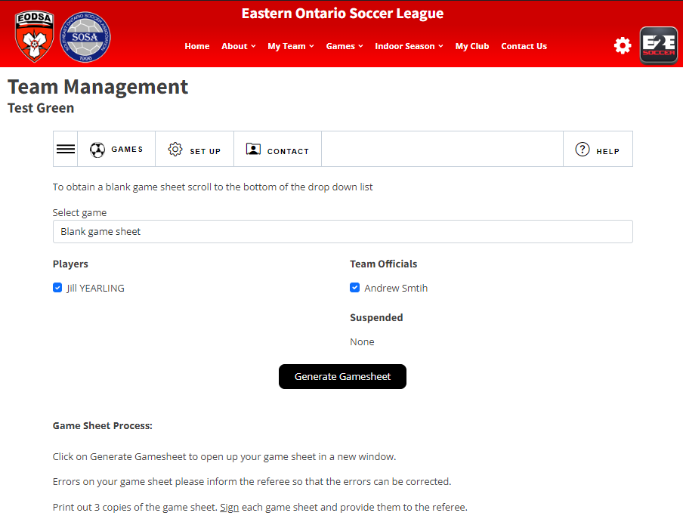
After you have entered your roster you can create a gamesheet
To do this go to the Games tab.
Click the 3 lines icon to see the options under Games, click gamesheets.
Choose your players who will be attending the game and click Generate Gamesheet
A gamesheet will appear in a new window.
Print it out and bring it to the game

Slide 18
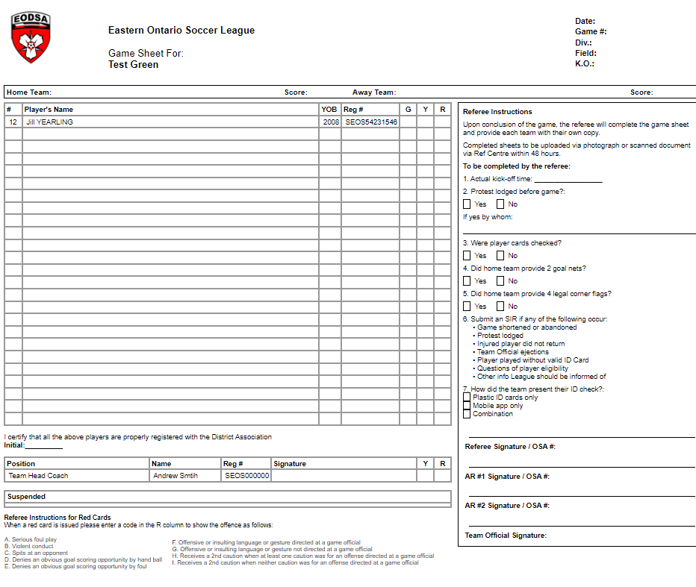




Sample gamesheet

Slide 19
ID Check Process
• Compare player and team official information on game sheet to information on the TRR, including the player and team official photos that are on the TRR
• If you notice a discrepancy, you must note it on the bottom of the game sheet
• If you believe the player to be ineligible, notify the player and their team official
• A Team Official must initial the game sheets in the appropriate box to certify that the card checking procedures were followed
• The Referee will note all questions or protests regarding a player’s eligibility or the validity of a player’s ID or TRR on the game sheet

Slide 20
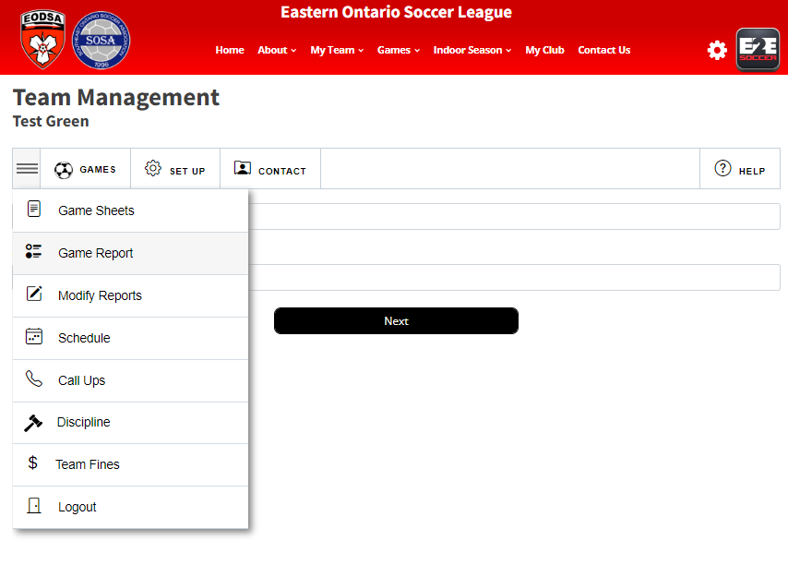
After the game go to the Game Report
tool to submit a report
Follow the instructions to completion
When both teams have entered a
game report the standings will be
updated

Slide 21
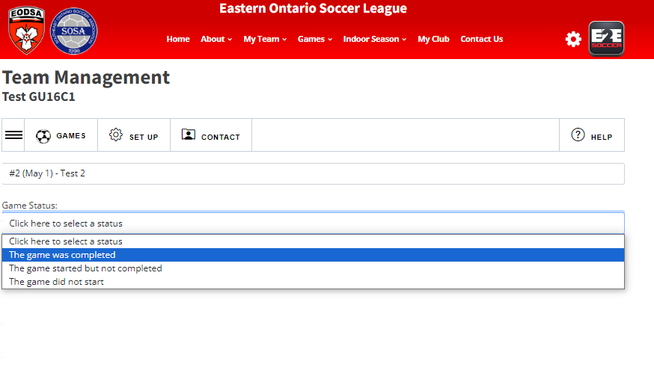
The web site will allow you to submit a game report from the field on your phone

Slide 22
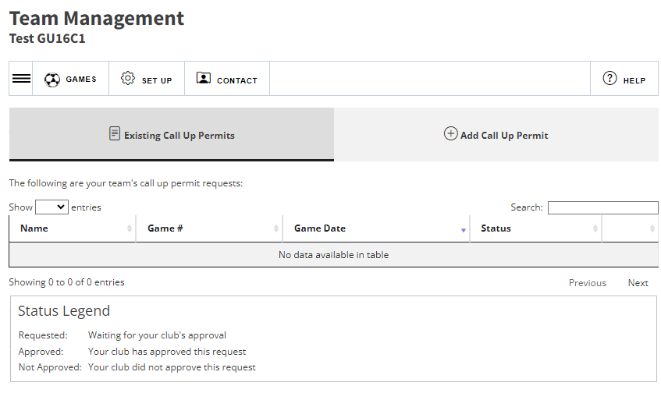
Call Ups
Use the link Call Ups (under Games tab) to Call up players within your club.
To add a new permit, Click Add Call Up Permit
NOTE – your club will enter the players available for call up outside of the EOSL (i.e. house league players)

Slide 23
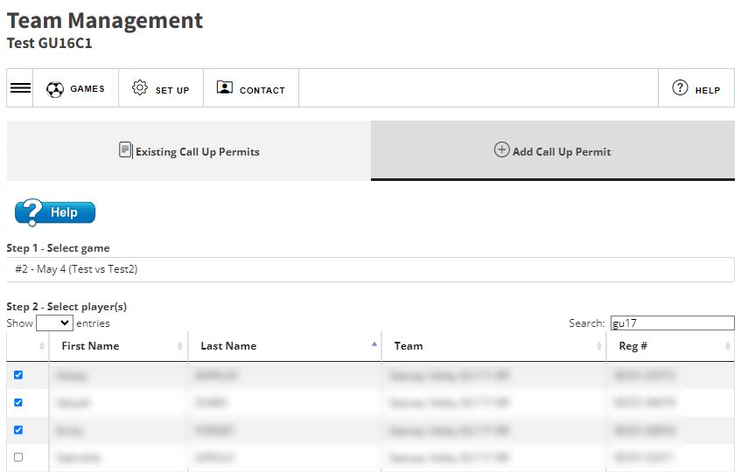
Select the game you wish to call up players too
Check off the players you wish to have play.
Click Submit Call Up Request
The green box will indicate that your request has been submitted
Your club reps will have to approve the permit.
Once approved, they will appear on the game sheet.
You can filter the list of players by using the search tool.
NOTE: The league will in no way approve a call up for any reason. Please plan accordingly.

Slide 24
Teams had a deadline of April 20th to submit two blackout times where the league will not schedule games
During the two-week summer break, if two teams agree, they may schedule a game. To inform the league, copy the opponent’s coach on an email to league@eodsa.ca to add the game.
No other games will be rescheduled except:
  At the discretion of the referee, at the field.
  A weather warning has been issued for the area of the field and the travel time is more than 1 hour to the field. The visiting team must notify the league by 2pm on the day of the game
  The League reschedules the game
  The referee does not show up and no replacement can be found
  The Municipality or venue closes the field, Not Clubs, but towns, cities or facility owners.
See the reschedule process on our website.
Reschedules

Slide 25
Kick-Off Times
2024 EODSL Kick-Off Time
Policy For all weeknight U9-U12 games the standard kick-off times will be as follows:
19:00 until August 14th
18:45 beginning August 15th
18:30 beginning September 1st
18:15 beginning September 15th
For all U13-U21 games the standard kick-off times will be as follows:
18:30 until August 14th
18:15 beginning August 15th
18:00 beginning September 1st
17:45 beginning September 15 (we expect most of these games will be played on weekends)

Slide 26
Other League Policies
Extreme Temperature Guidelines
Severe Weather and Lightning Policy
Air Quality Policy

Slide 27
U8 Festivals
U8 Festivals are being hosted by Clubs. Your Clubs have been supplied with a list of the festival hosts and dates.

Slide 28
Question Time
We will now take some questions on the new season.

