Slide 1


Team Managers & Coaches Pre-Season Meeting
May 13th & May 14th, 2025

Slide 2
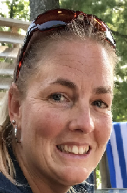
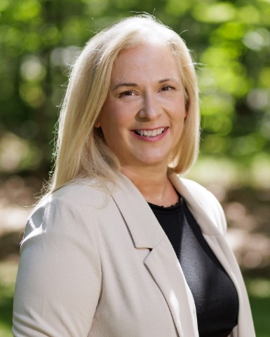
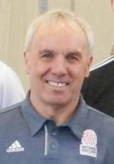
Introductions
Dawn Dinsdale
EOSL
League Administrator
Vicki Lowe
EODSA
Executive Director
David Smith
EODSA
Referee Co-Ordinator

Slide 3

Acronyms
TRR - Team Roster Report. This report comes from your Club and must go to all games It is an approved list of players and Team Officials
EOSL - East Ontario Soccer League
OSCAR - Also called Sports Engine, it is Ontario Soccer’s management and registration system
SEOS - Sports Engine Operating System - only used in reference to registration numbers (ie SEOS123456)
Grassroots – teams in Under 9 to Under 12

Slide 4
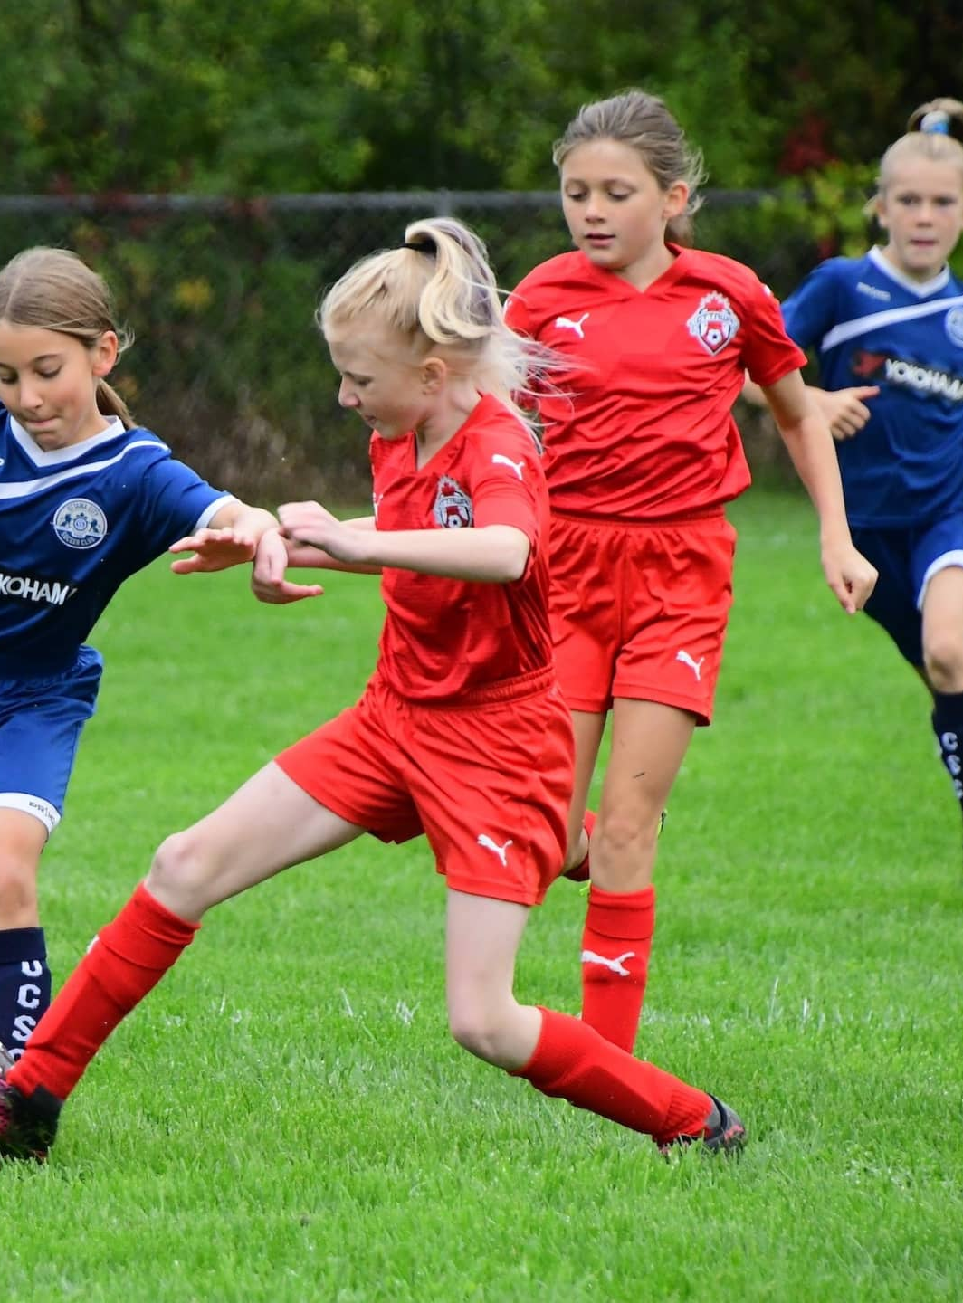

The 2025 EOSL season
Week of May 19th Season starts
Week of July 21st Start of two-week mid season break
Week of August 4th Season resumes
Week of August 18th Under 18 season concludes
Week of September 1st Last week of Summer Season
Week of September 29th All games to be played

Slide 5

League Website Information www.eosl.ca
Discipline - https://eosl.ca/discipline/
Rules - https://eosl.ca/league-rules-2/
Policies - https://eosl.ca/policies/
FAQ - https://eosl.ca/coach-manager-faq/

Slide 6
3.04 Maximum 20 players
3.05 The deadline for placing a player on a team roster is July 31st of each year
6.03 The names of players and team officials who are not present at the game must be crossed out on the game sheet. All players and team officials, including call-ups, whose names appear on the game sheet that are not crossed out, will be deemed to have played or participated in the game, and could be subject to disciplinary action based on being deemed to have participated in the game
6.04 When a game sheet cannot be printed from the LMS due to technical difficulties, the team will inform the EOSL by email that the team was unable to print the game sheet. Notice of the difficulty must be received prior to the game start time. If notice is received after the game start time, the team's Club will be subject to the applicable fine as per the published EOSL Fees and Fines Schedule
7.03 No protest pertaining to the eligibility of a player will be entertained if ID is not checked prior to the game. For further clarity, a notation must be made on the game sheet that the game is being played under protest.

Slide 7
11.02 Only the players listed on the game sheet and a maximum of 4 team officials are permitted to be in the designated technical area. All substitute players and team officials will confine themselves to their designated technical area
11.05 No coach or team official may enter the field of play at any time without the prior approval of the Referee
11.08 Clubs and team officials are always fully responsible, at all times, for the conduct of their players, other team officials and spectators, at and in the vicinity of any game in which their team participates, including the parking lot
12.03 If both teams jointly agree not to play a scheduled game, then each team will receive a loss (with no score) and nil points from that game and the teams will be subject to disciplinary action

Slide 8
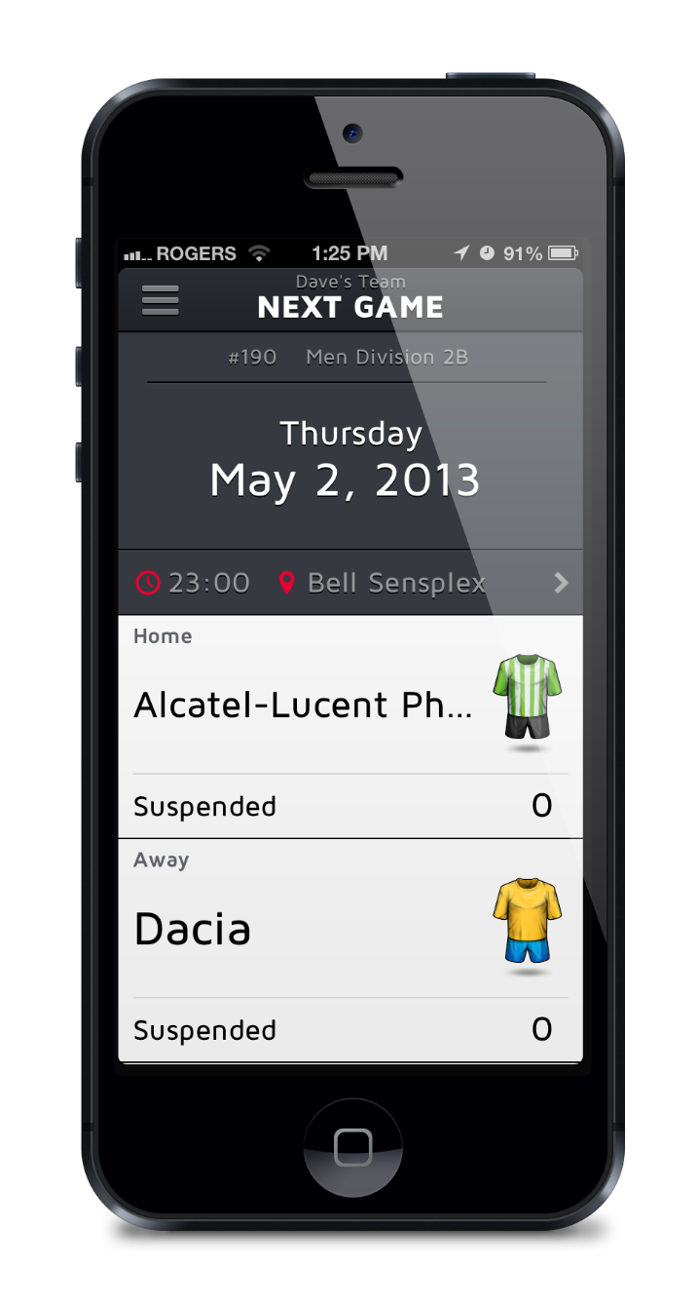
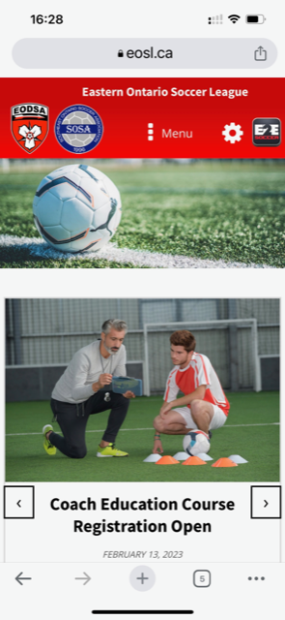
Website – Mobile Friendly
Your 2025 website is mobile friendly
The site will allow us to keep
you posted of league and other
soccer news
There is an app is called E2E Soccer League Centre

Slide 9
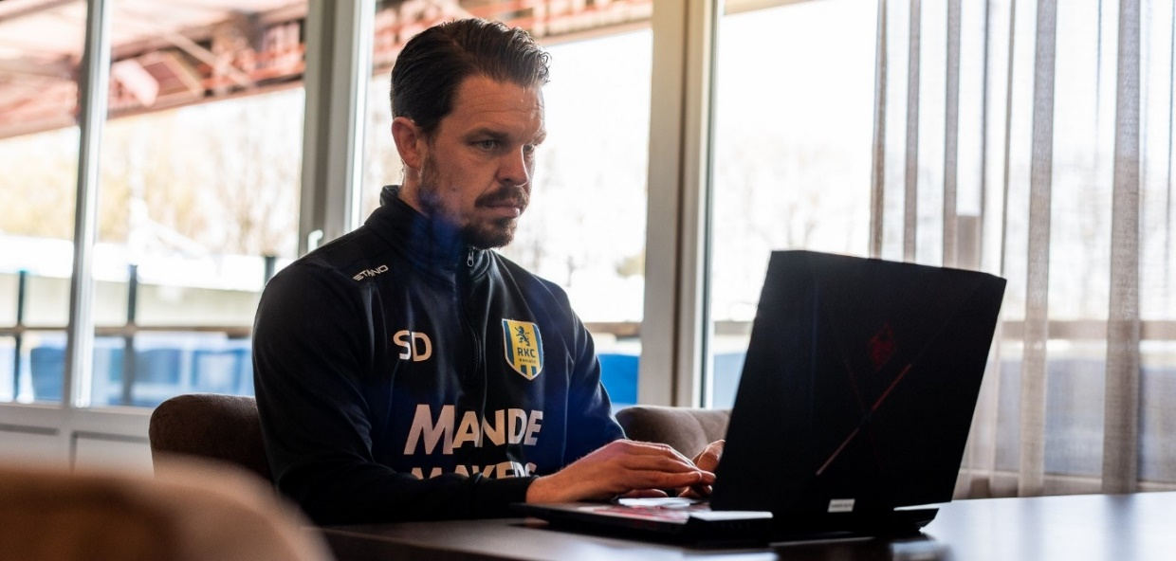
Setting up your team management account
These tasks need to be done before the start of the season
Every coach and team manager needs to perform an activation process
Your name won’t appear on game sheets until you have done this

Slide 10
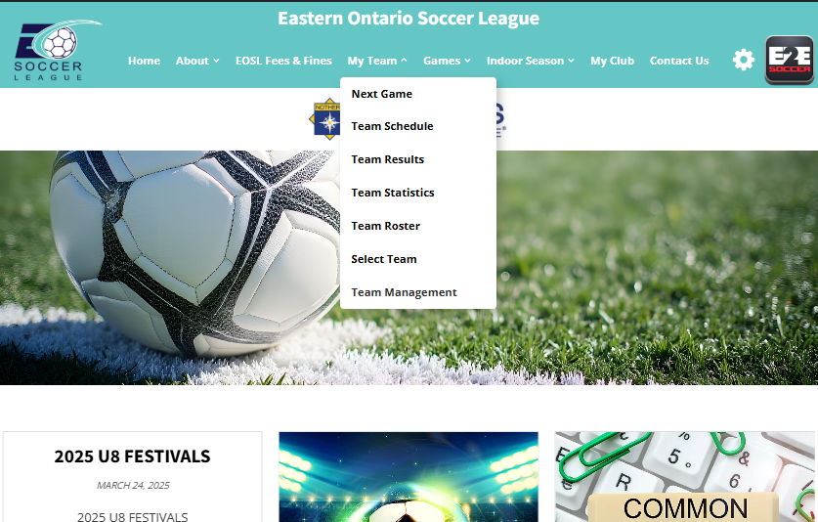
Each team manager and coach is required to set up an account with the site.
To do this go to the My Team and select Team Management

Slide 11
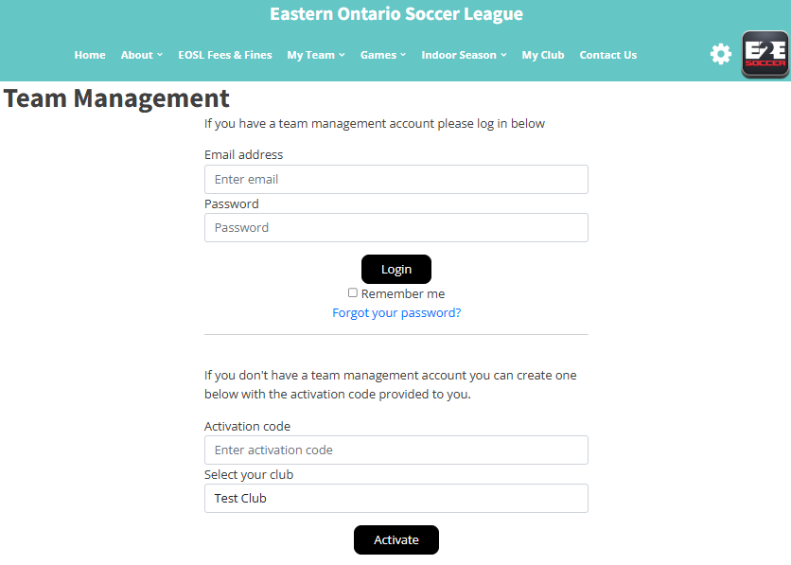
To activate your account, go here
and enter this activation code.
Contact your club for the code.
Choose your club's name from the drop-down menu
Then click the Activate button

Slide 12
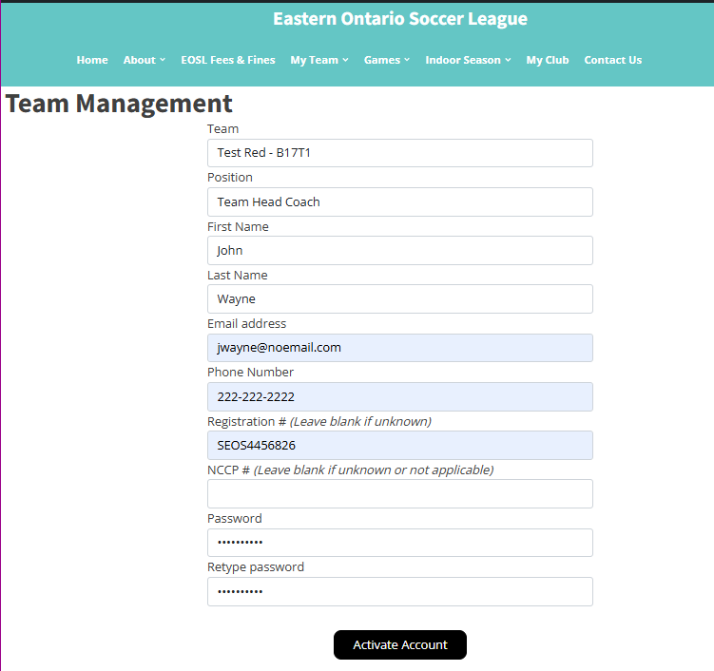
Make sure that you select the correct
team here
Fill in the rest of the page and click the
Activate Account button

Slide 13
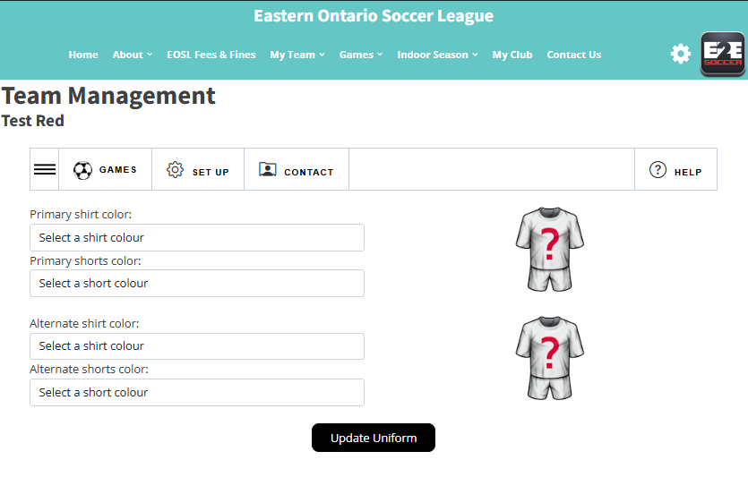
You will now be taken to the Team Management module
There are 4 tabs in this module
Games
Set Up
Contact
Help
Click on the 3 lines to open the submenus for each tab.
Notes:
Dawn – question, do all team officials enter uniform colours or just the first one. What if they enter different info?

Slide 14
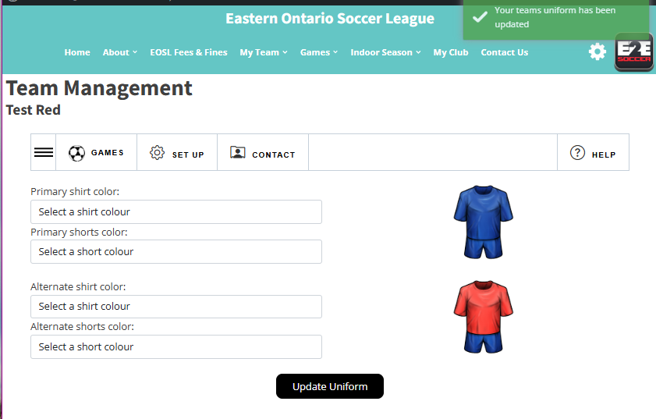
Start in the Set Up menu
First enter your uniform by selecting your shirt and shorts in the drop downs
Click the Update Uniform button to save
Notes:
Dawn – question, do all team officials enter uniform colours or just the first one. What if they enter different info?

Slide 15
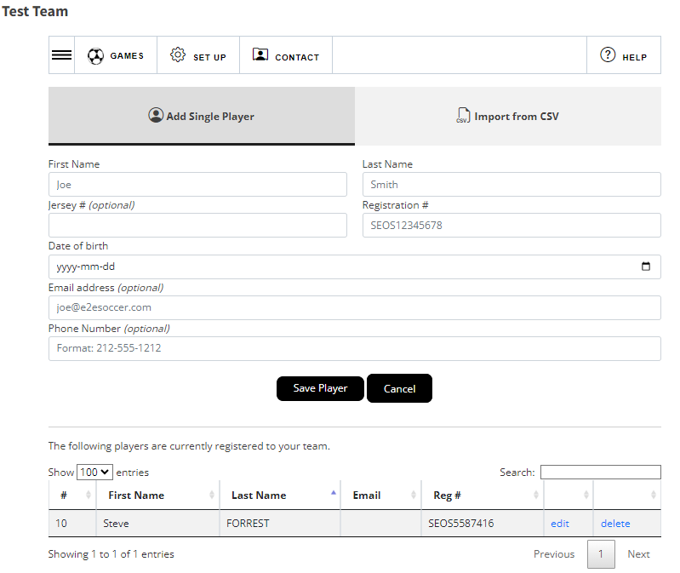
All rosters are being entered by the club – this would be U9 to U17.
If you need to add players, you can do so in this screen to add them individually
If you need to edit or delete the player use these links
Note – if deleting a player, they are not removed from the league database. Their status will have changed to be inactive.
Notes:
Dawn – question, do all team officials enter uniform colours or just the first one. What if they enter different info?

Slide 16
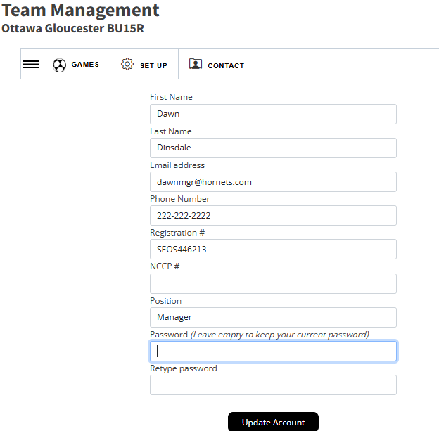
If you failed to enter your SEOS number during the activation process, you must update it later under Set Up/My Account.
SEOS numbers MUST be entered and appear on the game sheets.
Your SEOS number is on the TRR, on your Sports Engine account, and your Club will know it
Any other information needing to be updated can be done here as well.
Notes:
Dawn – question, do all team officials enter uniform colours or just the first one. What if they enter different info?

Slide 17
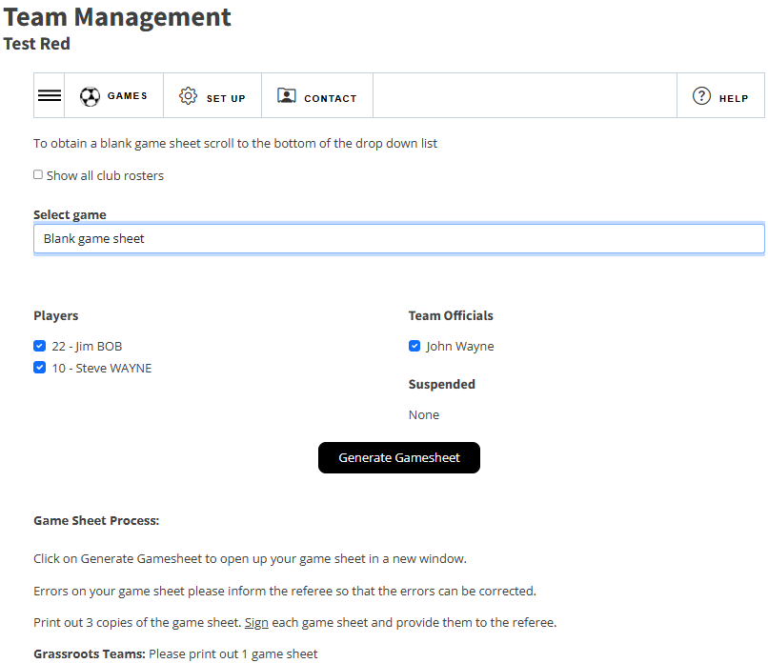
After you have entered your roster, you can create a gamesheet
To do this go to the Games tab.
Click the 3 lines icon to see the options under Games, click gamesheets.
Choose your players who will be attending the game and click Generate Gamesheet
A gamesheet will appear in a new window.
Print it out and bring it to the game
Notes:
Dawn – question, do all team officials enter uniform colours or just the first one. What if they enter different info?

Slide 18
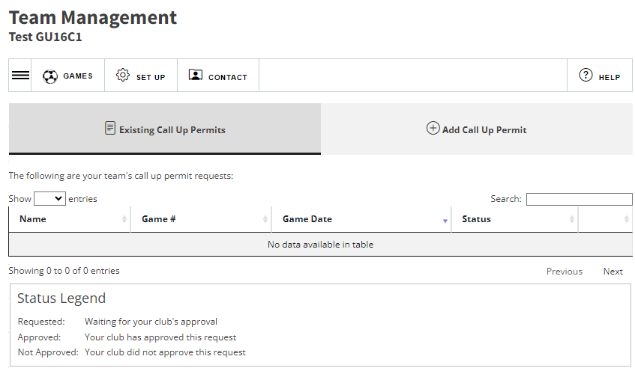
Call Ups
Use the link Call Ups (under Games tab) to Call up players within your club.
To add a new permit, Click Add Call Up Permit
NOTE – your club will enter the players available for call up outside of the EOSL (i.e. house league players)

Slide 19
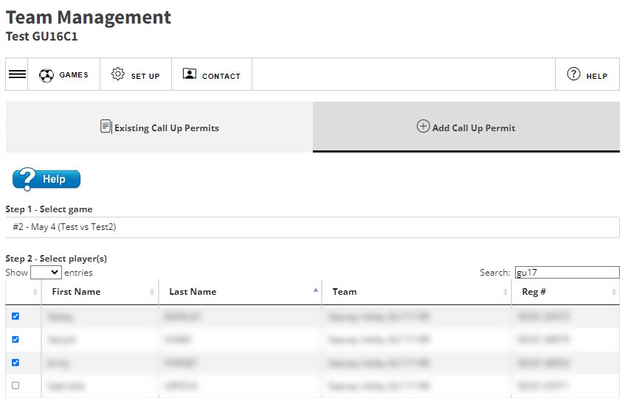
Select the game you wish to call up players too
Check off the players you wish to have play.
Click Submit Call Up Request
The green box will indicate that your request has been submitted
Your club reps will have to approve the permit.
Once approved, they will appear on the game sheet.
You can filter the list of players by using the search tool.
NOTE: The league will in no way approve a call up for any reason. Please plan accordingly.
Notes:
Dawn – question, do all team officials enter uniform colours or just the first one. What if they enter different info?

Slide 20
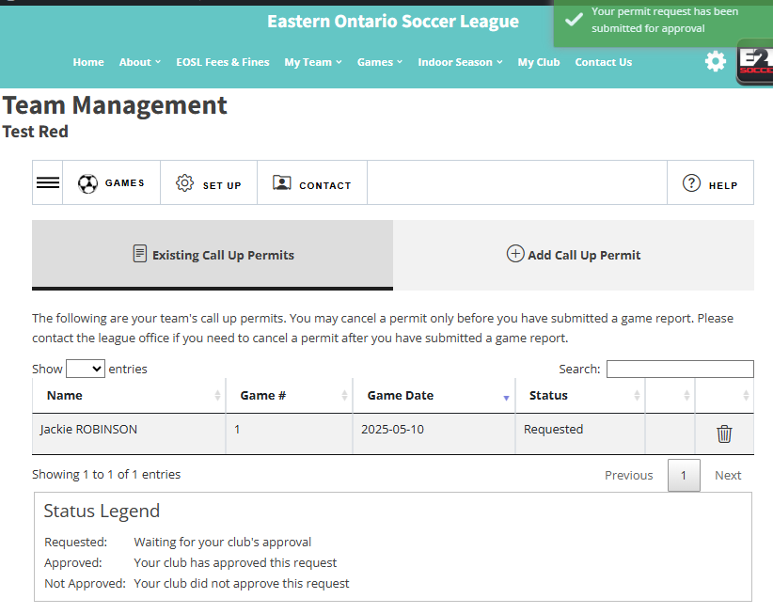
A green message in the upper right corner will confirm your request has been submitted to your club.
Once your club has approved the call-up, the player will be added to the roster for the game.
Notes:
Dawn – question, do all team officials enter uniform colours or just the first one. What if they enter different info?

Slide 21
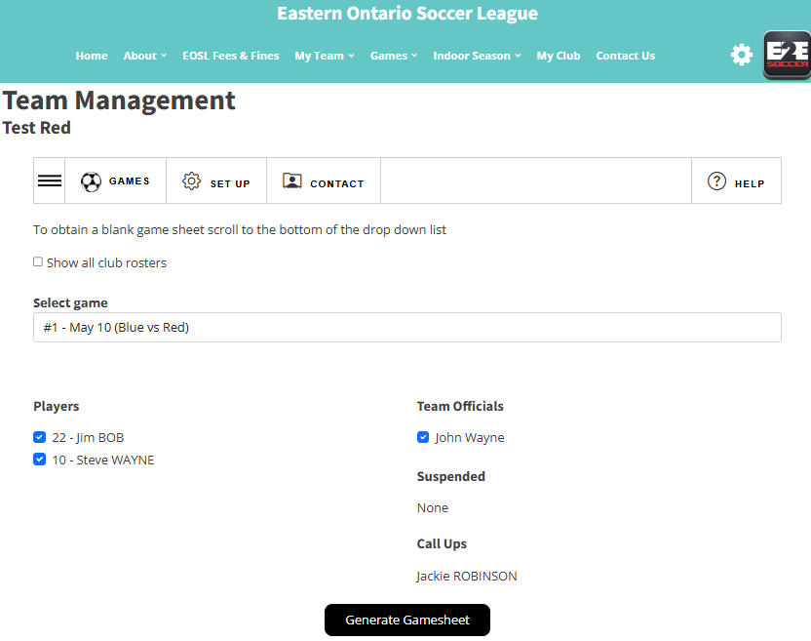
Once the call up has been approved they will be listed below
When preparing for your game, click on Generate Gamesheet.
Notes:
Dawn – question, do all team officials enter uniform colours or just the first one. What if they enter different info?

Slide 22
Select the game you wish to call up players too
Check off the players you wish to have play.
Click Submit Call Up Request
The green box will indicate that your request has been submitted
Your club reps will have to approve the permit.
Once approved, they will appear on the game sheet.
You can filter the list of players by using the search tool.
NOTE: The league will in no way approve a call up for any reason. Please plan accordingly.

Slide 23
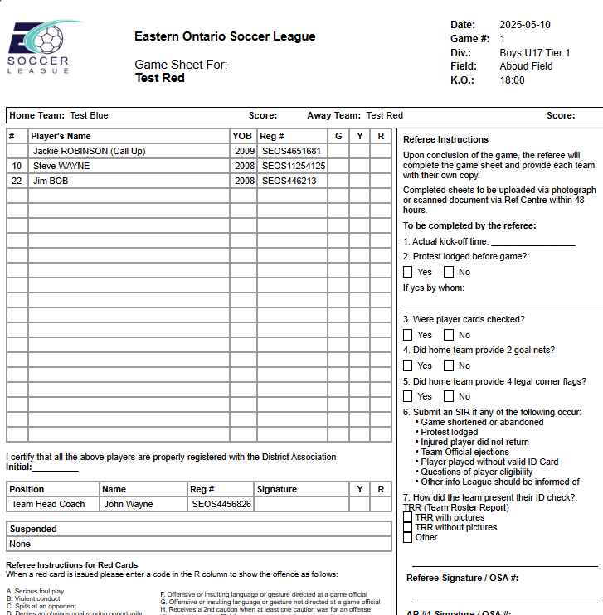
Sample gamesheet
Important Actions regarding the gamesheet
Ensure all players have their jersey number listed on the game sheet.
All team officials who will be on the bench must have their SEOS number listed on the gamesheet as well as sign the gamesheet.
Any team protesting a game MUST do so before the game starts or when a team becomes aware of an issue which is grounds for protest.

Slide 24
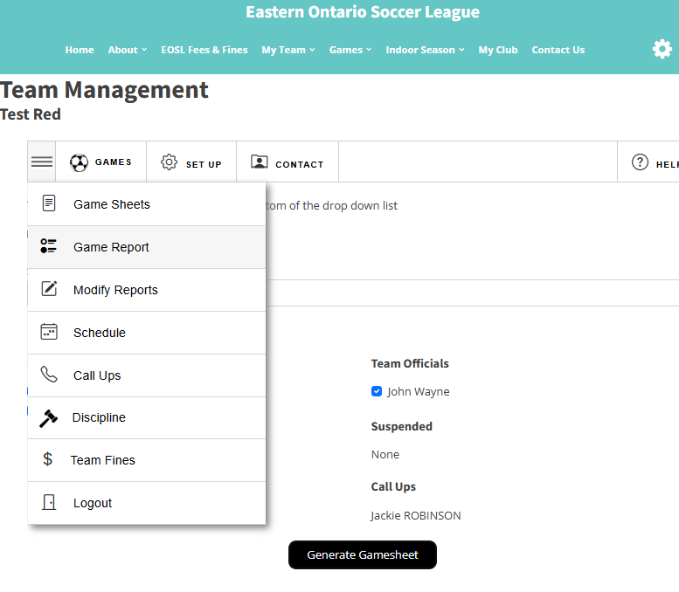
After the game go to the Game Report
tool to submit a report
Follow the instructions to completion
When both teams have entered a
game report the standings will be
updated
Notes:
Dawn – question, do all team officials enter uniform colours or just the first one. What if they enter different info?

Slide 25
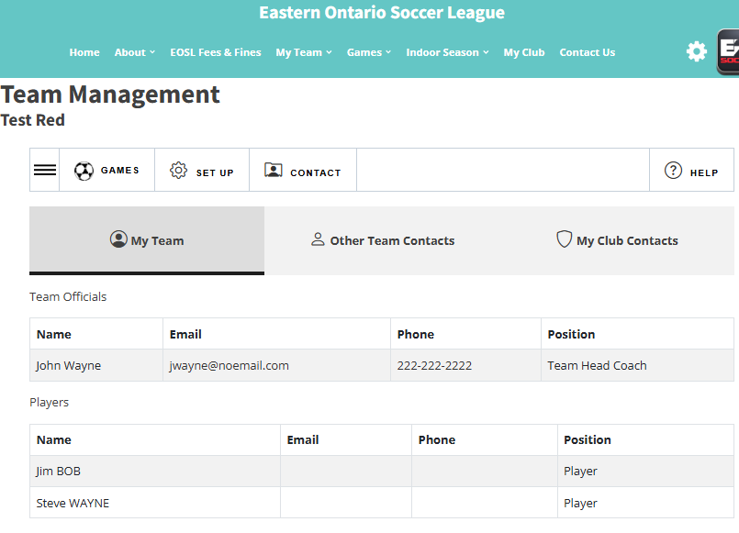
When you click on Contact, there are 3 tabs:
My Team
Other Team Contacts
My Club Contact
Please use this when contacting your team or opponents.
Please contact your Club if you need assistance setting up your team. They will contact the league if they can’t help you.
Notes:
Dawn – question, do all team officials enter uniform colours or just the first one. What if they enter different info?

Slide 26
ID Check Process
Compare player and team official information on the game sheet to information on the TRR, including the player and team official photos that are on the TRR
If you notice a discrepancy, you must note it on the bottom of the game sheet
If you believe the player to be ineligible, notify your opponents team officials.
A Team Official must initial the game sheets in the appropriate box to certify that the card checking procedures were followed
The Referee will note all questions or protests regarding a player’s eligibility or the validity of a player’s ID or TRR on the game sheet
Notes:
Dawn – question, do all team officials enter uniform colours or just the first one. What if they enter different info?

Slide 27
Call Up Rules - Regional and District
5.01 Team may call up players as follows:
  OPDL players are subject to the restrictions of OPDL Play-up rules.
  Regional teams may call up players from any younger-aged Regional team. Regional teams may also call up players from any District division or the Club’s House League. In both cases, the player must be registered to a team of the same age group or younger.
  District teams may not call up players from Regional teams.
  District teams may call up players from any lower-tier District division or the Club’s House League. In both cases, the player must be registered to a team of the same age group or younger.
  U13 teams may not call up from U12 or younger.
  Called-up players must not be suspended by any League or governing organization affiliated with OS.
  If a player is registered in competitive and recreational, they may only be called up from the competitive team.
  Subject to all other conditions in this section, players may be called up a maximum of six times per season.
5.02 Registered age is the age the player is registered to in the OS registration database.
5.03 Call-ups are administered through the LMS. When a team requests a call-up through the LMS, their Club must approve the call-up in the LMS. If the call-up is club-approved, the player’s name will appear on the game sheet, indicating that they are a call-up.
5.04 Players playing as call-ups must bring the TRR from the team they are registered with and a valid ID to the game.
5.05 A team’s age classification in the LMS may differ from that in the OS Registration System. The OS Team Registration age can be seen on a team’s TRR. The age in the OS registration system is used when determining which players are eligible to be called up to a team in a combined age group (i.e. Girls U15/16). For example, a team registered with OS as a U15 team playing in a Girl's U15/16 age division cannot use a U16 player as a call-up. A team playing in the same division and registered as a U16 team with OS can use a U16 player as a call-up, subject to the restrictions outlined in rule 5.01.
Notes:
Dawn – question, do all team officials enter uniform colours or just the first one. What if they enter different info?

Slide 28
Reschedules
Teams had a deadline of April 15th to submit two blackout times where the league will not schedule games
During the two-week summer break, if two teams agree, they may schedule a game. To inform the league, copy the opponent’s coach on an email to league@eosoccer.ca to add the game.
No other games will be rescheduled except:
  At the discretion of the referee, at the field.
  A weather warning has been issued for the area of the field and the travel time is more than 1 hour to the field. The visiting team must notify the league by 2pm on the day of the game
  The League reschedules the game
  The referee does not show up and no replacement can be found
  The Municipality or venue closes the field, Not Clubs, but towns, cities or facility owners.
See the reschedule process on our website.
Notes:
Dawn – question, do all team officials enter uniform colours or just the first one. What if they enter different info?

Slide 29
2025 Kick Off Times
Policy For all weeknight U9-U12 games the standard kick-off times will be as follows:
  19:00 until August 14th
  18:45 beginning August 15th
  18:30 beginning September 1st
  18:15 beginning September 15th
For all U13-U17 games the standard kick-off times will be as follows:
  18:30 until August 14th
  18:15 beginning August 15th
  18:00 beginning September 1st
  17:45 beginning September 15 (we expect most of these games will be played on weekends)
Notes:
Dawn – question, do all team officials enter uniform colours or just the first one. What if they enter different info?

Slide 30
Other League Policies
Extreme Temperature Guidelines
Severe Weather and Lightning Policy
Air Quality Policy

Slide 31
U8 Festivals
U8 Festivals are being hosted by Clubs.
Your Clubs have been supplied with a list of the festival hosts and dates.
Notes:
Dawn – question, do all team officials enter uniform colours or just the first one. What if they enter different info?

Slide 32
Question Time
We will now take some questions on the new season.

