Slide 1
EOSL
Team Management

Slide 2
About E2E Soccer
Company was founded in 2003
We are located in Ottawa
We provide IT solutions for the soccer community
Our products allow our customers to automate their operations in a cost-effective manner
Our goal is to provide the customer with an end to end or E2E solution

Slide 3
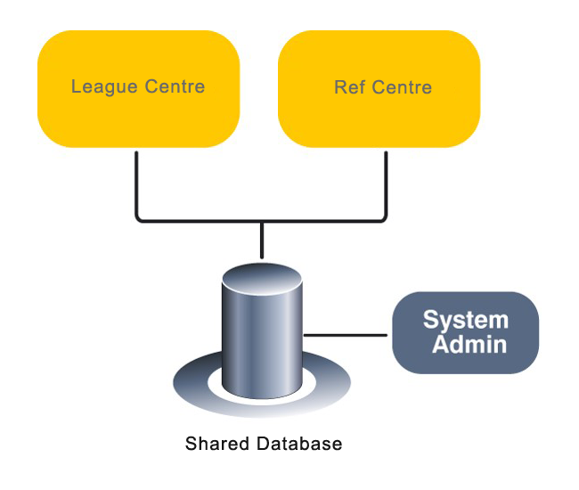
The EOSL solution

Slide 4
League management roles and responsibilities
League staff Club staff Team staff Players
Generate schedule
Review game sheets
Discipline management
Operate the league
Team oversight
Create club rosters
Approve call ups
Club management
Generate game sheets
Submit game reports
Request call ups
Manage reschedules
Read only

Slide 5
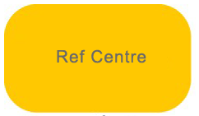
Referee management roles and responsibilities
League staff Club staff Assigner Referees
Referee oversight
Pay referees
Referee oversight
Pay referees
Assign referees
Support referees
Accept game offers
Submit game reports
Submit discipline
Upload game sheets

Slide 6
The EOSL website is now at
https://eosl.ca/

Slide 7
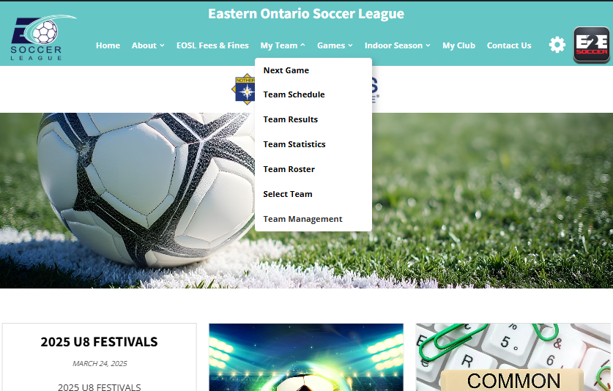
Each team manager and coach is
required to set up an account with
the site.
To do this go to the My Team and select Team Management

Slide 8
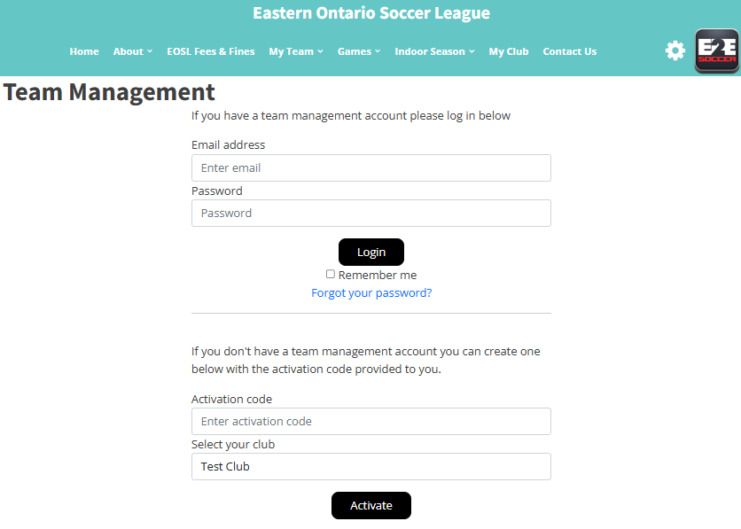
To activate your account, go here
and enter this activation code.
Contact your club for the code.
Choose your club's name from the drop-down menu
Then click the Activate button

Slide 9
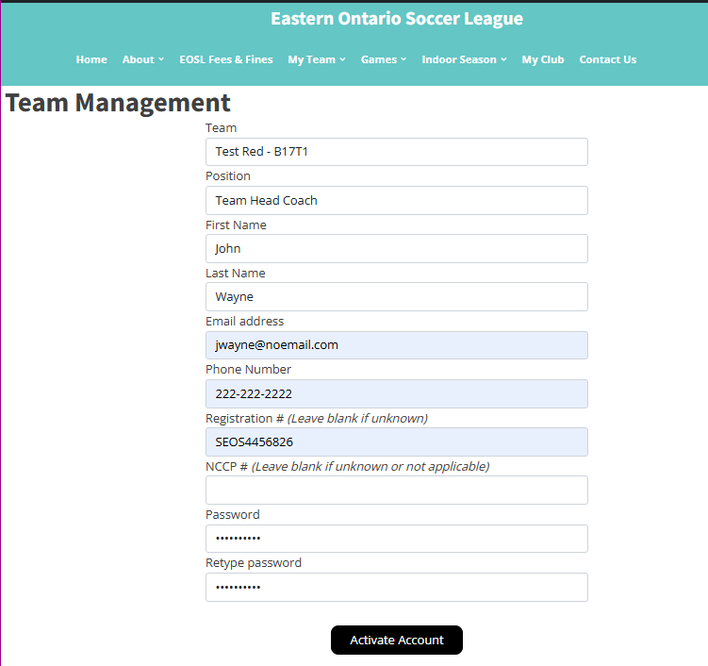
Make sure that you select the correct
team here
Fill in the rest of the page and click the
Activate Account button

Slide 10
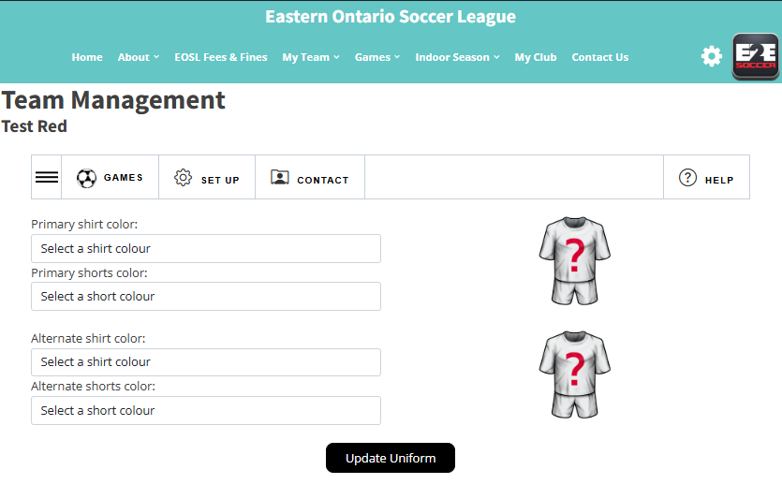
You will now be taken to the Team
Management module
There are 4 tabs in this module
Games
Set Up
Contact
Help
Click on the 3 lines to open the submenus for each tab.

Slide 11
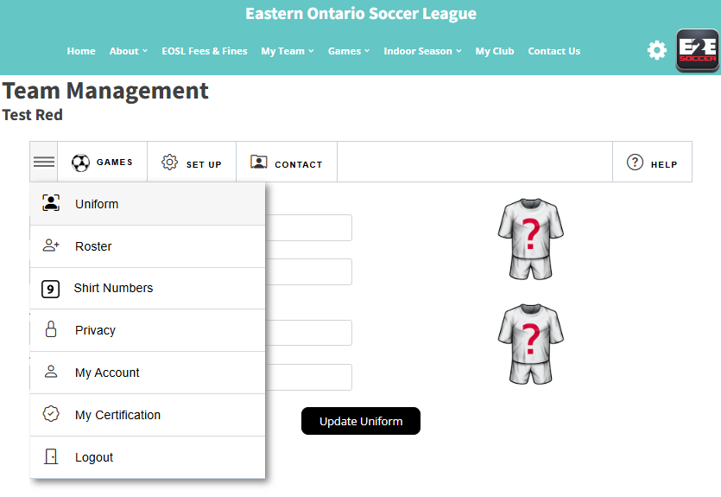
In each tab is a series of tools
Click on the button to visit that tool

Slide 12
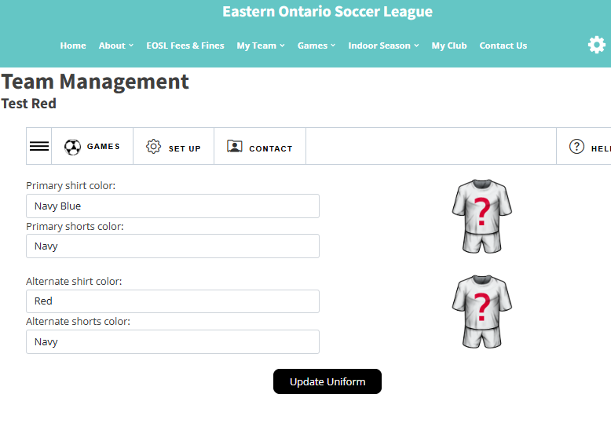
Start in the Set Up menu
First enter your uniform by selecting
your shirt and shorts in the drop downs
Click the Update Uniform button to save

Slide 13
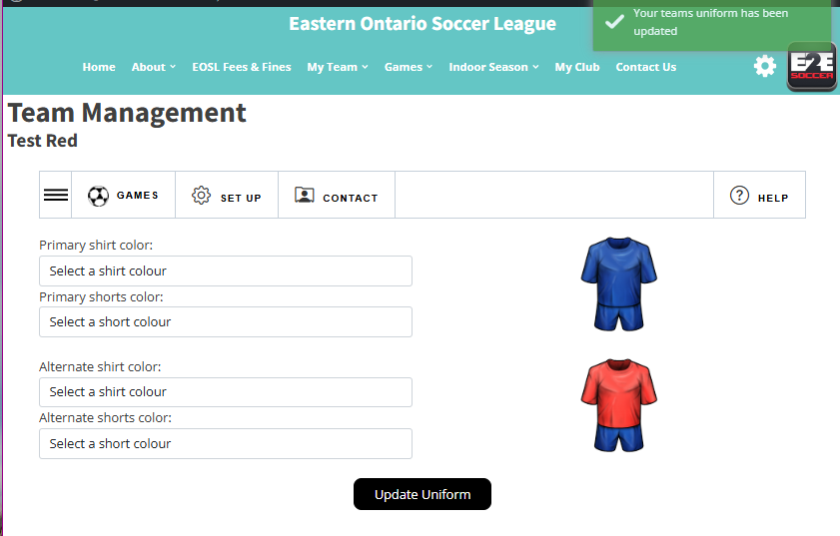
A green message will tell you that the
action was successful
It will be red if there is a problem

Slide 14
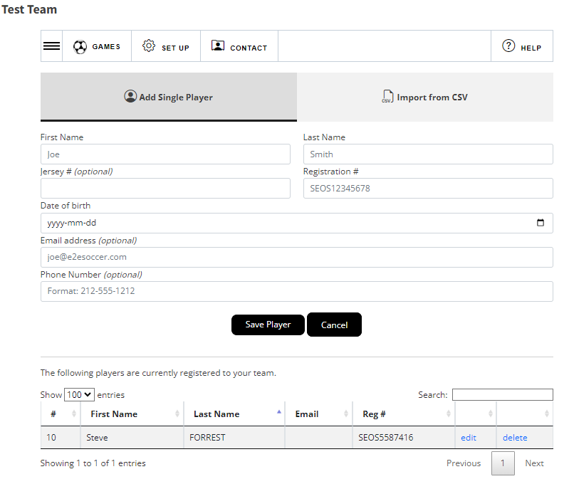
Clubs are responsible for adding players to your roster.
After the players have been added he or she will be listed in the table below the buttons
If you need to edit or delete the
player use these links
Note – if deleting a player, they are not removed from the league database. Their status will have changed to be inactive.

Slide 15
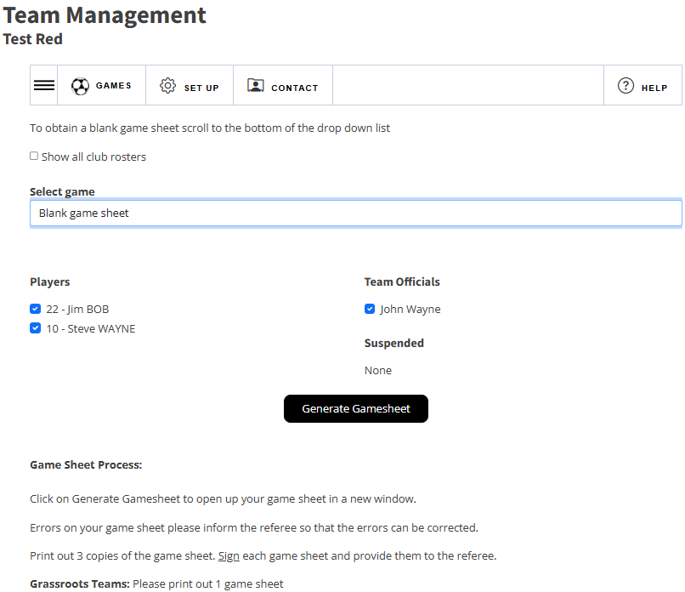
After your roster has been entered,
you can create a gamesheet
To do this go to the Games tab.
Gamesheets will be available on your page.
Click the 3 lines icon to see the other options under Games,
Choose your players who will be attending the game and click Generate Gamesheet
A gamesheet will appear in a new
window.
Print it out and bring it to the game

Slide 16
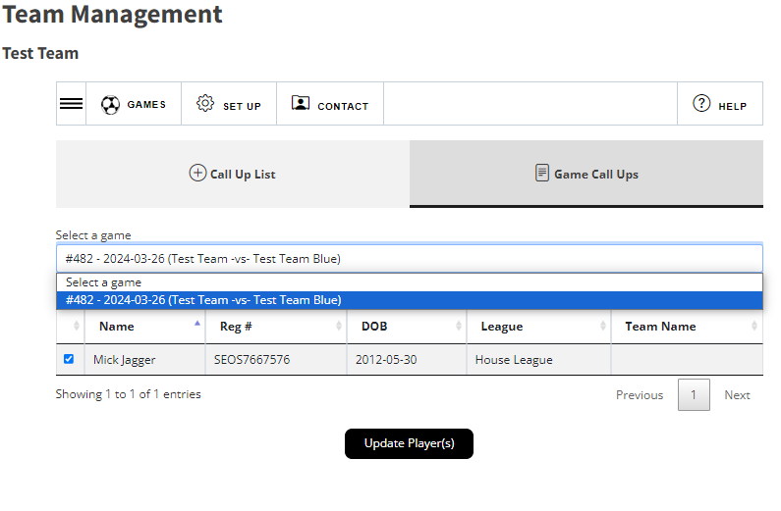
Clubs are responsible for adding players outside the league to the database for calling up.
Once your player has been added to the league database, click on Game Call Ups.
Select a game from your schedule.
Click the box beside the player’s name, click update player(s).

Slide 17
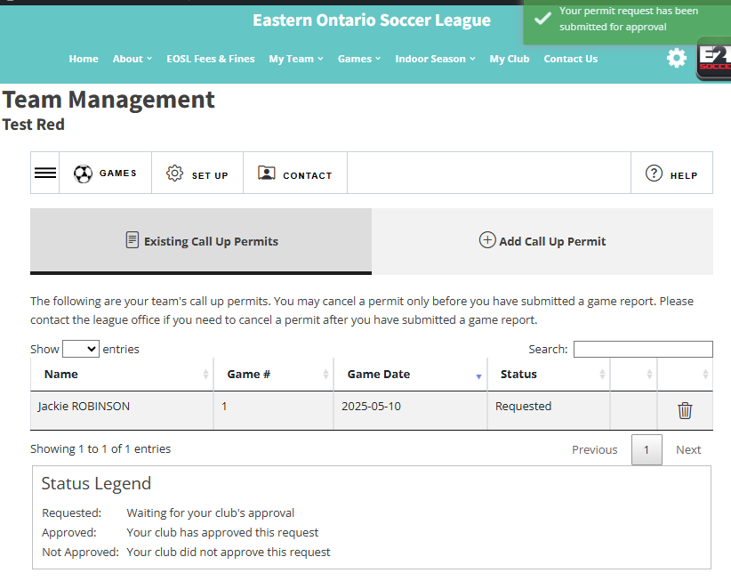
A green message in the upper right corner will confirm your request has been submitted to your club.
Once your club has approved the call-up, the player will be added to the roster for the game.

Slide 18
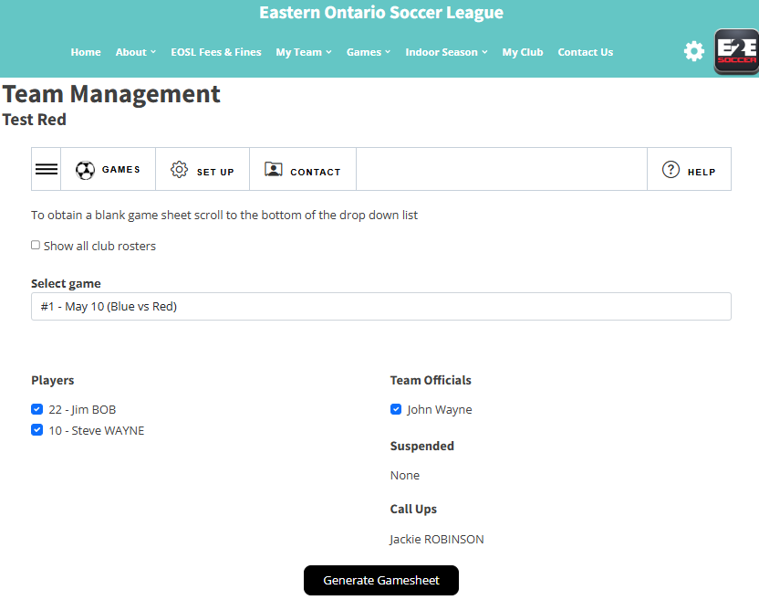
Once the call up has been approved they will be listed below
When preparing for your game, click on Generate Gamesheet.

Slide 19
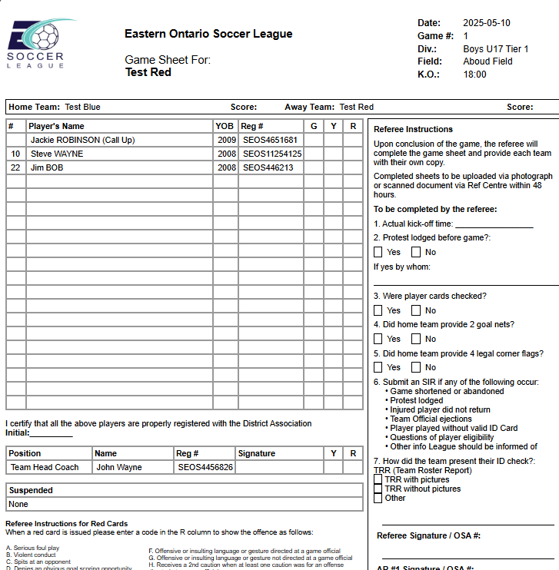
Sample gamesheet

Slide 20
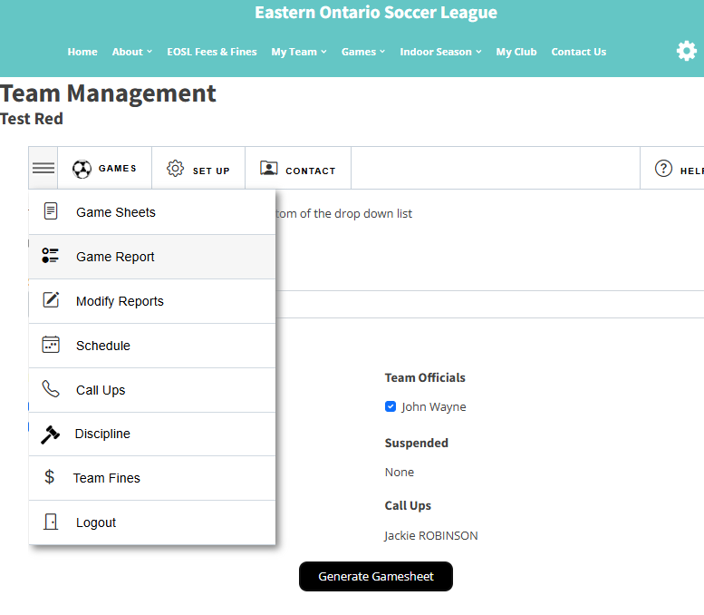
After the game go to the Game Report
tool to submit a report
Follow the instructions to completion
When both teams have entered a
game report the standings will be
updated

Slide 21
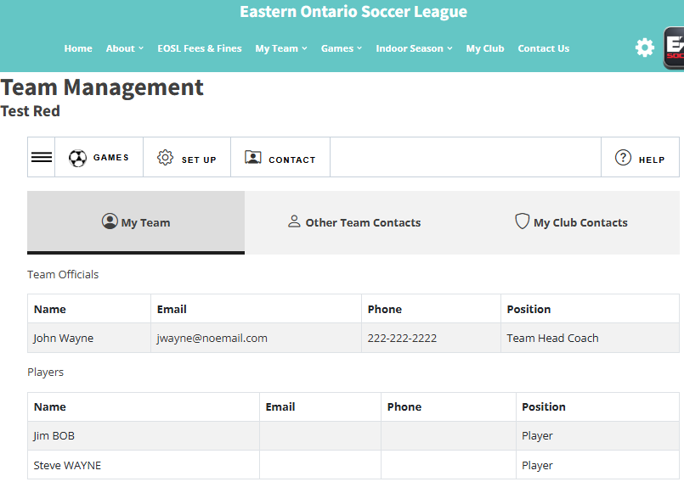
When you click on Contact, there are 3 tabs:
My Team
Other Team Contacts
My Club Contact
Please use this when contacting your team or opponents.
Please contact the EOSL staff in you need assistance setting up your Team
Management account

